Slide 1
Changing Results for
Young Readers (CR4YR)
January – April
2015
Year 3
Welcome Respected Colleagues
Notes:
8:30 am

Slide 2
A Provincial Initiative...
Goal: To increase the number of engaged, successful readers in our province
Notes:
8:30 am a provincial initiative launched in 2012 that provides funding to districts to release teachers in order to meet the goal of
Three years later we are still working towards the same key goal but in North Vancouver we have introduced some changes to the structure and focus for CR4YR this year, which I will present this morning.

Slide 3
Snapshot of…
Focus on one child
Opportunity for teachers to collaborate
Teacher inquiry relevant to reading instruction
Collection of provincial data to inform practice
Notes:
What works for one child will certainly be helpful or enlightening in terms of
60 districts participated in the first two years
Used a framework of inquiry – encouraging teachers to develop hunches and experiment collaboratively with school teams to develop strategies and interventions for struggling readers
Data collected by the Ministry has been shared and provides some interesting insights into the types of strategies that work for vulnerable students

Slide 4
Year 1 and 2 of CR4YR
Provincial Framework…
Early Reading Facilitators & Early Reading Advocates
Teams from five schools selected
Seven morning sessions throughout the year
Data collected and submitted to the Ministry
Notes:
Year 1 – Teachers and LATs from Norgate, Westview, Q Mary, Lynnmour and S Hts
Year 2 – Teachers and SLPs from Brooksbank, Lynnmour, CC, S Park, Windsor and Carson – pilot “adolescent literacy” project
Self-Regulation – work of Nancy Perry, Deborah Butler, Kimberley Schonert-Reichl
Aboriginal Worldviews presented by leaders in BC - Trish Rosborough, Laura Tait, Paige Fisher

Slide 5
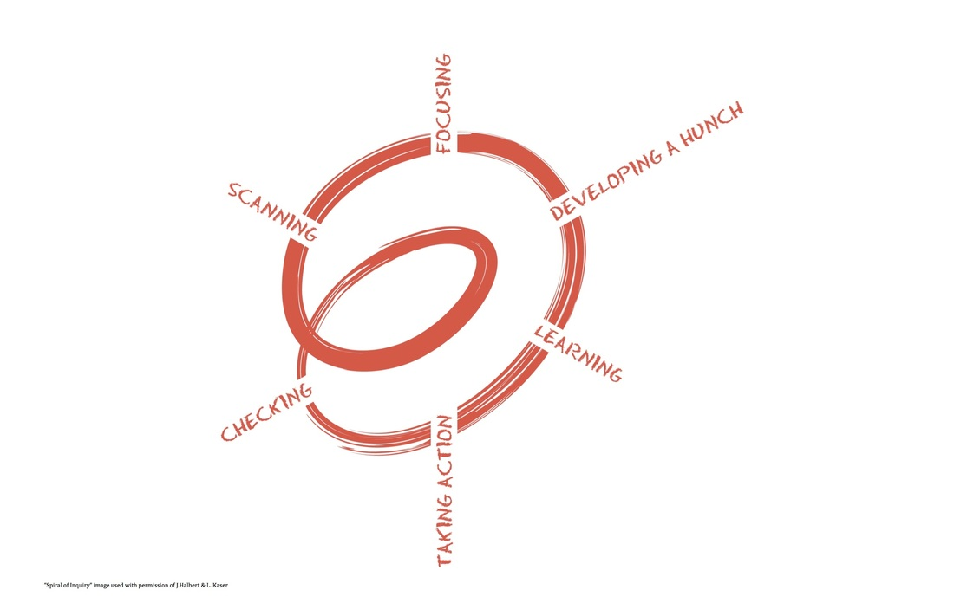
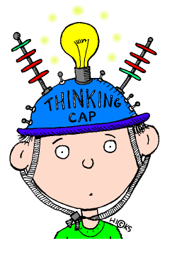
Feedback from Year 1 & 2
Continued focus on:
Teacher Inquiry
Self- Regulation
Aboriginal Worldviews and Indigenizing the Curriculum
Best practices for Reading Instruction
Less reflection & more “substance” - strategies for instruction & assessment
More teachers to participate
Fewer sessions
Evidence-based practices for instruction, assessment & intervention for struggling readers

Slide 6
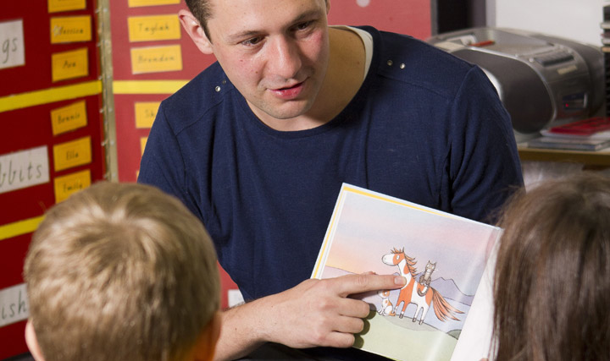
CR4YR Project Goals
Increase the number of NVSD students who are engaged, proficient readers by Grade 3
Maximize the collective knowledge of primary teachers
Support a community of practice at all schools focused on improving results for struggling readers
Enhance teachers’ understanding of literacy instruction & assessment for the full continuum of learners
Establish a district-wide understanding of the Core Components of Literacy Instruction…
Notes:
Last spring met to review the feedback and to develop goals for year 3
Collective Knowledge – Reading 44, Writing 44, Firm Foundations, OTTT – used by teachers worldwide

Slide 7
CR4YR 2015
A new NVSD Leadership Team…
District Early Reading Advocate (Ilona Wardas)
District Leadership Team (FOS Leaders, teachers)
Kendra Arkinstall
Doreen Berg
Ann Copp
Diana Kilby
Anne Lawson
Janet McLean
Heather Myhre
Shannon Sharp
Claire Spofforth
Stephanie Weller
Notes:
INTRODUCE TEAM HERE.

Slide 8
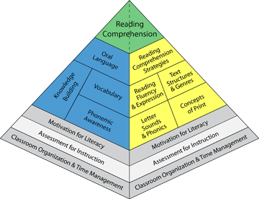
A New CR4YR Format
Session 1 – Building the Foundations for Learning
Engaging the Literacy Learner and Self-Regulated Learning
Differentiated Instruction
Indigenizing the Reading Curriculum
Misconceptions and Myths regarding Reading Instruction
Session 2 and 3– Developmental Stages of Reading
Oral Language
Phonemic Awareness & Phonics
Reading Fluency
Vocabulary development
Reading Comprehension
Session 4 – Putting Research into Action
Assessment Tools, Intervention Strategies, Collaborative Planning
Notes:
All Primary Teachers and LATs from across the district invited to attend 4 interactive sessions
Leadership team has developed a framework that explores all components of literacy instruction and promotes research-based best practices
**session 1 added Differentiated Instruction
**session 4 removed Instructional Strategies added Collaborative Planning

Slide 9
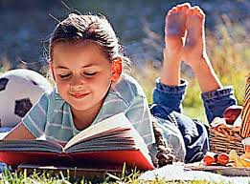
CR4YR Websites
http://changingresultsforyoungreaders.bclibraries.ca/
https://cr4yrnvsd44.wordpress.com/
Notes:
8:40 - ilona to introduce…. Websites to visit
Resource links including these sessions - readings, resources, handouts
Plan for today is to acknowledge what we are already doing and to make room for small changes with the support of a collaborative teaching team at your school…. Or at other schools… look around the room.

Slide 10
Big Ideas
Strategic teaching practice will have an impact on students’ approach to learning and their success as skilled, proficient, purposeful readers.
When learning is examined through the eyes of students Educators can better help students become their own teachers: as critical planners; as receivers of feedback; and as adaptive learning experts.
Notes:
8:45 -8:47 Big Ideas as core understandings - A conceptual Framework ( Grant Wiggins) Authentic Education
My undergrad work was with Selma Wasserman at SFU in 1990. Teaching for Thinking was and still is a guided by Big Ideas or conceptual frameworks. Big Ideas take time to unpack and need to be revisited often in the course of study. Today will be a starting place to examine our own teaching practice as individuals and as collaborative teams
Plan with the end in mind. At the end of this session you will have a taste of the research as well as multiple places and resources to support your own inquiry/learning/development
Understanding by Design UbD… Backwards design
Big Ideas take time to unpack – not all in this session but through examination of practice, embracing the research, getting to know self and learners

Slide 11
Learning Targets Session #1
I will enhance my understanding of learner engagement and what is needed to support the growth of the self-regulated learner.
I will develop a beginning understanding of Aboriginal Principles of Learning.
I will offer and seek collegial support in the assessment and growth of my own practice.
Through the process of Inquiry, I will create a plan to incorporate a practice that is different to me so that I can better support one struggling reader.
I will leave with a question to explore.
Notes:
8:47- 8:49 am – clearly stated learning intentions / targets
Beginning with the end in mind. Some of what is presented today may already be part of your daily practice and some ideas will be new. Some practices and strategies may need to be dusted off, revisited, and refined. We have educators in this room with anywhere from 1 – 21+ years of experience.
5 targets – animate
Throughout the 4 sessions we will be presenting information from current research and exemplars from real teachers and classroom practice. We will also direct you to multiple resources both online and in book form. Some will be familiar to you, some may be new.

Slide 12
Motivation and Engagement are foundational to Balanced Literacy Learning
Motivation and student engagement – the self regulated learner
Assessment for Instruction
Classroom organization Teaching to Diversity Differentiated Instruction
Graphic from: University of Toronto “balanced literacy diet”
www.litdiet.org How to Videos Motivation #56
Notes:
8:49 – 9:00 Pyramid graphic courtesy of U of Toronto – GREAT graphic - Let’s hang out in this GREY ZONE for the session. http://www.oise.utoronto.ca/balancedliteracydiet/Motivation_for_Literacy/index.html
Attention to every component is necessary in supporting students on their journey to becoming Engaged Skilled readers. LEARNERS NEED SKILL and WILL p 223 Reading 44 Core understandings about learning to read. NEXT SLIDE
Assessment for instruction will be embedded throughout the exemplars.
We will look more deeply at assessment and feedback in the 4th session.
Click on link to University of Toronto BALANCED LITERACY
Video #56 1:53

Slide 13
Reading 44 A Core Reading Framework 1999 revised 2004
Reading Research Tab
“To be engaged readers, students must recognize the value of reading and their own potential as readers and learners. Readers need both the skill and the will to read.”
Reading 44 (p 223)
Notes:
9:05 Refocus (Learning stage of Spiral) on the NVSD 44 document compiling research and practice.
Session #1 will focus on the “will” … and the role teachers play in helping students recognize their strengths and view themselves as Literacy Learners at whatever stage in the process they present. ENGAGEMENT, MOTIVATION, SELF-REGULATED
Strategies used throughout the sessions will come from this resource as well as others.
Dust it off. Re-read. Whatever your stage of practice. Try new things- visit and contribute to the eBOOK

Slide 14
The Inquiry Process
Focusing
Scanning
What does our focus need to be?
What’s going on for our learners?
Developing a Hunch
What is leading to this situation?
Checking
Learning
Have we made enough of a difference?
How and where can we learn more about what to do?
Taking Action
What will we do differently?
Notes:
9:05-9:10 Teachers and teams will have graphic organizers to begin reflections and inquiry question – What’s going on in our province? Some of the research that has gone into the exciting, provocative New Provincial Curriculum - spiral is borrowed from document (show) Handouts JUDY HALBERT & LINDA KASER As much as possible we will provide sources, resources as this is just the starting point. We will use this graphic/process as much as possible to reflect upon and refine our own practice. An example of “metacognition” in professional practice.

Slide 15
Self-Assessment …a place to start… Formative Assessment
A Fearless Inventory
Self assessments will affirm and inform a starting place
Some challenging and provocative statements
Take 10 minutes to yourself
Begin a conversation with your school team about this experience in general or about the statements specifically. Discuss any themes or questions that emerged for you.
Notes:
9:10 Keep this for yourself. Share and discuss with a colleague.
We will revisit this self assessment during the final session.Show HATTIE book from which it was adapted.
Adapted from John Hattie’s recent work “Visible Learning For Teachers Maximizing Impact on Learning (2012). We will hear more from Hattie’s fascinating work in the area of Learning and Teaching later on in today’s session.

Slide 16
The Research Says…. Dr. John Hattie Visible Learning for Teachers Maximizing Impact On Learning , 2012
Professor John Hattie is a researcher in education. Currently the Director of Melbourne Educational Research Institute at the U of Melbourne, Australia since March 2011.
Previously, he was a project director and Professor of Education at the U of Auckland, New Zealand.
Holds a PhD from the University of Toronto, Canada
Ranking Ladder Group Task 5 mins
www.visible-learning.org
Notes:
9:15 – 9:25 15 years of research. 3 books. Millions of learners, meta-analysis of over 900 research papers looking at what actually works in schools to raise the achievement of students. Including motivation , curriculum, meta-cognitive strategies, behavior, teaching strategies, classroom management
GO TO NEXT SLIDE to discuss EFFECT SIZE

Slide 17
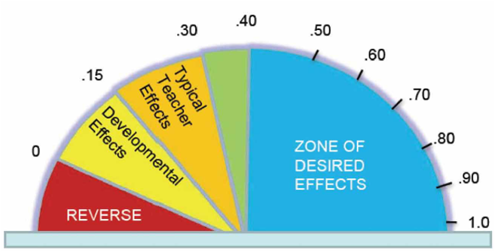
Influences and Effect Sizes Related to Student Achievement
1. (1.44) Helping students develop high expectations for themselves
3. (1.07) Response to Intervention
4. (0.90) Educators providing their colleagues with formative assessment
feedback on their teaching practices
6. (0.88) Direct teaching of phonics to a small group of students who need it
10. (0.75) Providing feedback to a student on his/her reading fluency
11. (0.74) Reciprocal Teaching
12. (0.72) Teacher - Student relationships
Notes:
9:20 – 9:30 John Hattie looked ranked 150 different influences see page 267 SO NOT ADVANCE til after ranking ladder task

Slide 18
14. (0.69) Teaching meta-cognitive skills (eg: think alouds during reading)
17. (0.67) Explicit teaching of vocabulary
23. (0.62) Professional Development / Growth
36. (0.54 - 0.6) Phonics instruction for the whole class
46. (0.52) Interactive Video Methods
91. (0.31) Inquiry based models of teaching
94. (0.29) Homework (e.g. spelling lists)
Notes:
9:35 This leads into the Inquiry Process. What process can we follow to examine our TEACHER EFFECTS on students and make room for change.

Slide 19
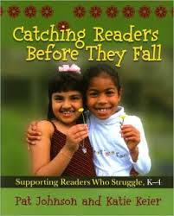
The Struggling Reader What do we see?
Reframing our thinking about behavior
Anxious about school
Lack self confidence
What is going on in the learning environment for these kids?
Defiant
Avoidant
Social challenges
Notes:
9:50 An awareness of WHERE students are in their Literacy development refer to Vygotsky ZPD
Introduce Catching Readers Before they fall Pat Johnson and Katie Keier (2010)
TELL BRAEDEN story about “sabotage”. I was aware of Brandons story Inquiry
When we talk about motivation and engagement we see all kinds of behaviors in our classrooms… because we have all kinds of learners at different places in their development. We can do something about this
Advanced reading Guthrie identifies 8 “contexts” or environments or practices that influence a student’s motivation and engagement.

Slide 20
Engaging the Literacy Learner
“Engagement is strongly related to reading achievement.” (Guthrie, 2001)
Notes:
9:15-9:17 John T. Guthrie 8 key points. Some of you may have read this
This article was emailed and posted on our new CR4YR website
John Guthrie is a professor in the Department of Human Development, University of Maryland (3304C Benjamin Building, College Park MD 20742, USA) and director of the Maryland Literacy Research Center.
Teachers Create the context
• Identify a knowledge goal, a purpose, and announce it (SHOW LEARNING TARGET.. use in LAC)
• Provide a brief real-world experience related to the goal
• Teach cognitive strategies that empower students to succeed in reading the text
• Assure social collaboration for learning
• Align evaluation of student work with the instructional context

Slide 21
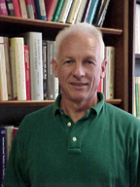
Instructional Contexts for Engagement
Learning and Knowledge Goals
Real World Interaction
Autonomy Support - Choice
Interesting Texts
Strategy Instruction
Collaboration
Praise **
Evaluation **
(Guthrie, 2001)
**Session #4 will dig deeper into more recent research on the effects of feedback
Notes:
9:55 Table group task: each table discusses one of the descriptors.
John Guthrie is a professor in the Department of Human Development, University of Maryland (3304C Benjamin Building, College Park MD 20742, USA) and director of the Maryland Literacy Research Center.
Create a context.. An environment, a way of doing things
• Identify a knowledge goal, a purpose, and announce it… ensure the target matches the learning place of the student.
• Provide a brief real-world experience related to the goal
• Teach cognitive strategies that empower students to succeed in reading the text
• Assure social collaboration for learning STUDENT and TEACHER
• Align evaluation of student work with the instructional context
Many of these key features will reappear in our discussion of the Self-Regulated Learner

Slide 22
The Engaged Reader What do we see?
Reframing our thinking about behavior
Excited to learn – seeks challenges
Self confident – strategic
Ask questions – seeks feedback
Curious - welcomes error
What is going in the learning environment for these kids?
Makes personal and social connections
Notes:
What can we do in our classrooms and practice that support engagement with a variety of learners. DIVERSITY. Differentiated instruction.. 2nd half of session
An awareness of WHERE students are in their Literacy development refer to Vygotsky ZPD
Introduce Catching Readers Before they fall Pat Johnson and Katie Keier (2010)
When we talk about motivation and engagement we see all kinds of behaviors in our classrooms… because we have all kinds of learners at different places in their development. We can do something about this

Slide 23
Notes:
9:40 Heather and Jessica – First Nations Principles of Learning.

Slide 24
Group Conversation
Read and discuss the phrases at your table
In what ways do you connect personally, professionally, collaboratively with these phrases?
Find and discuss evidence of these phrases in your practice and in the learning environment of your school
Notes:
10: 40 Heather 3 – 4 mins conversation at table group. Come together

Slide 28
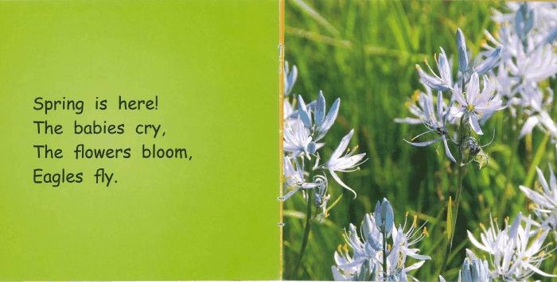

Slide 31
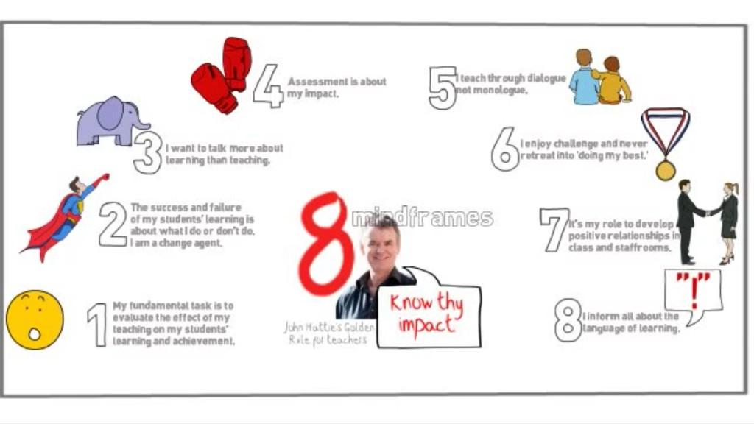
Brain and Body Break
https://www.youtube.com/watch?v=6xpcXobZF1k
Notes:
10:15 break 3:30 sec run through video

Slide 32
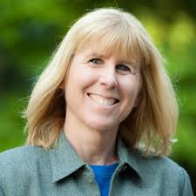
Self-Regulated Learning
Self-Regulation – Brain research, sensory processing, emotional regulation, cognitive regulation, metacognitive strategies
UBC Debra Butler and Nancy Perry
Self Regulated Learners are:
a) metacognitive
b) direct emotions and behavior
c) motivated for learning
d) strategic
http://www.youtube.com/watch?v=ifkQ7SgSSQw
Notes:
10:05 Deb Butler’s presentation is an hour long. October 2013 CR4YR in-service.Play first minute with Maureen Dockendorf BC Superintendent of Reading begin at 3:54 - (5 minutes)

Slide 33
Self Regulated Learning Occurs in Classrooms Where….
a) Students’ autonomy is supported
b) Teachers provide strategic support
c) Teachers engage in non-threatening evaluation practices
Canadian Consortium for Self-Regulated Learning
http://srlcanada.ca/
Notes:
10:02- 10:05 HANDOUT notes from UBC also online at the UBC Now return to that struggling reader. Throughout the session you have no doubt had thoughts, questions about a particular student. Think about the student who is NOT regulating their learning… what does that look like?UBC is currently offering a Masters Degree Program in self regulated learning

Slide 34
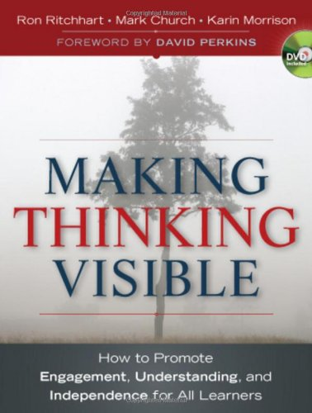
Self-Regulated Learning
A big topic with multiple entry points and perspectives.
3-2-1 Bridge Strategy
Write 3 words
Write 2 questions about Self Regulation
Write 1 metaphor or simile
Ritchhart, Church, Morrison (2011)
Notes:
BRIDGE – have a discussion with your group on ways your thoughts may shifted or changed. Discuss with your table group. This will offer students an opportunity to be “metacognitive”. It is not uncommon for first words to be nouns then shift to more verbs or adjectives
Has thinking shifted from “what do students do?” to “what can I do?”
Blank paper… 3 words (quick associations), 2 questions (not too deep uncovering surface ideas at this point), 1 metaphor or Simile “self regulated learning is…” or “self regulated learning is like…
AFTER THE BREAK… Introduce HEATHER MYRE… another element to ‘getting to know your learners’ and çontexts for learning.

Slide 35
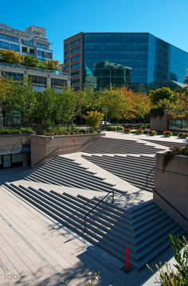
UDL Universal Design for Learning
Planning for diversity from the beginning…
Notes:
Originated in the field of architecture Architect Ronald L. Mace
Creation of structures to make access easier for disabled people – benefits more than just disabled and less costly/time-consuming than retrofitting –curb ramps, automatic doors,
When we apply this to education....
Consider the needs of the broadest range of learners in the initial design of a lesson or unit

Slide 36
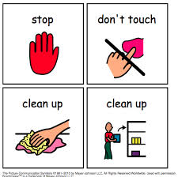
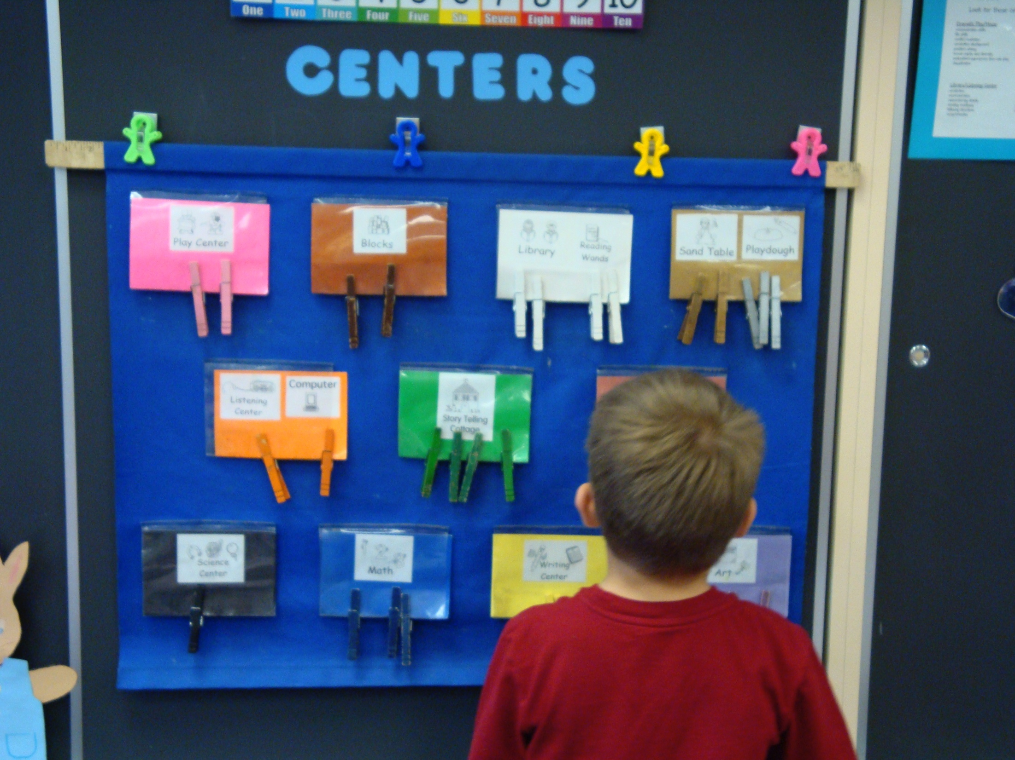
When Apply UDL to Education…
Multiple means of Representation
Multiple means of Expression
Multiple means of Engagement

Slide 37
Differentiating Learning…
Proactively adjusting teaching and learning methods to accommodate different learning needs

Slide 38
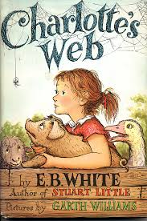
The Starting Point…
Differentiation is in how students learn, not in what they learn.
Karen Hume
The starting point is the learning goal,
not the activity.
Notes:
Proactive vs. Reactive differentiation starts with a common learning goal
All students need to work towards the same learning goals.

Slide 39
Group Task
Learning Goal: Demonstrate an understanding of the relationships between characters in a story.
Anchor task: ???
Take 5 minutes with your table group to talk about how you would differentiate the anchor task based on student interests and/or abilities
Use the Teaching to Diversity handout
Notes:
Differentiation is not individualized learning. Most students will be able to do the anchor task
Limited range of choices

Slide 40
Notes:
11:05 – 11:15 discuss balance of thirds - focus on one student – may not have all the answers today (ie: student self assessment) Examples of professional questions.

Slide 41
Fact or Myth?
1. Learning to read, like learning to talk, is a natural process.
2. With time, all children will eventually learn to read.
3. Genetics rule: if the child has dyslexia, he or she cannot be helped.
4. If you start at a disadvantage, you will never catch up.
5. After Grade 3, children are done learning how to read.
6. Children can learn to read by relying heavily on context cues.
7. Students can master reading comprehension if they just read, read, and read.
8. English has so many irregular spellings and inconsistencies that it is impossible to teach.
From Foundations of Literacy: An Evidence-based Toolkit for the Effective Reading and Writing Teacher (Canadian Language and Literacy Research Network, pp. 14
Notes:
11:25 Handout with explanations

Slide 42
Exploding Reading Myths
Please work in a small group for this activity
Read the statements in “Exploding Reading Myths”
Discuss the reasons why you think each of the statements is a ‘myth’ and not a true statement.
Try to provide examples from your own classroom practice
Notes:
Parents, teachers, students, and society in general, may be heard repeating myths they have encountered related to the acquisition of reading skills such as those listed below. Many of these myths, which are not based on scientific research, have been passed on and continue to be prevalent in homes and classrooms. No matter what the source of the myths, students deserve research-based teaching practices that have been proven to work. Included below are research findings that explode some common myths.

Slide 43
Revisit Learning Targets
I will enhance my understanding of learner engagement and what is needed to support the growth of the self-regulated learner.
I will develop a beginning understanding of Aboriginal Principles of Learning.
I will offer and seek collegial support in the assessment and growth of my own practice.
Through the process of Inquiry, I will create a plan to incorporate a practice that is different to me so that I can better support one struggling reader.
I will leave with a question to explore.

Slide 44
In Your Seat Door Prize
Thank you from your CR4YR colleagues

