Slide 1

Changing Results for
Young Readers
CR4YR Intermediate Series
January 2016
Year 4
Notes:
8:30 am

Slide 2
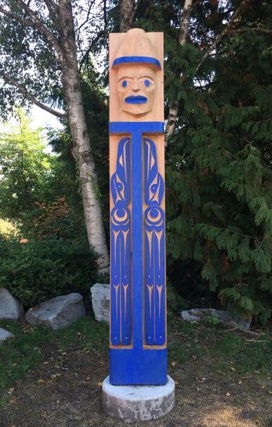
Traditional Welcome
We would like to start by acknowledging and thanking the Coast Salish people whose traditional territory North Vancouver School District resides on.
We express our gratitude to the
Squamish Nation and
the Tsleil-Waututh Nation.
We value the opportunity to learn, live and share educational experiences on this traditional territory.
Notes:
Kathleen 5 mins

Slide 3
Reconnaissance du territoire traditionnel
J’aimerais reconnaître et remercier
les peuples autochtones de la côte Salish dont leur territoire traditionnel
est le siège de la Commission scolaire
de Vancouver Nord.
Nous exprimons notre gratitude envers
les Nations Squamish et Tsleil-Waututh.
Nous apprécions l’occasion d’apprendre, de vivre et de partager des expériences éducatives sur ce territoire traditionnel.
Notes:
Kathleen

Slide 4
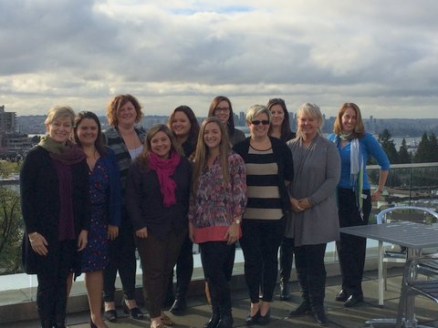
CR4YR 2016 Leadership Team
      Kammi Clark
      Ann Copp
      Jenny Crowe
      Jillian Gordon
      Cheryl Ham
      Johneen Harris
      Jessica Johnson
      Heather Myhre
      Nicky Paiuk
      Nadya Rickard
      Darlene Sulis
      Stephanie Weller
Notes:
INTRODUCE TEAM HERE.

Slide 5
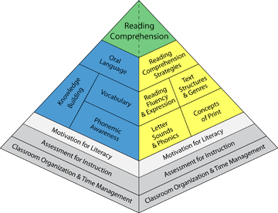
Review Session #1
To enhance Literacy Leader and teacher capacity in literacy instruction
To understand the intermediate reader
To explore literacy resources and
strategies for the intermediate
classroom
University of Toronto “balanced literacy diet”www.litdiet.org

Slide 6
Review Session #2
To understand the importance of fluency and oral language in the intermediate classroom
To explore and enhance strategies for teaching and assessing oral language and fluency

Slide 7
Learning Targets Session #3
Explore aspects of comprehension
Understand how comprehension changes and develops in the intermediate grades
Enhance teacher's repertoire of strategies to help struggling readers with comprehension

Slide 8
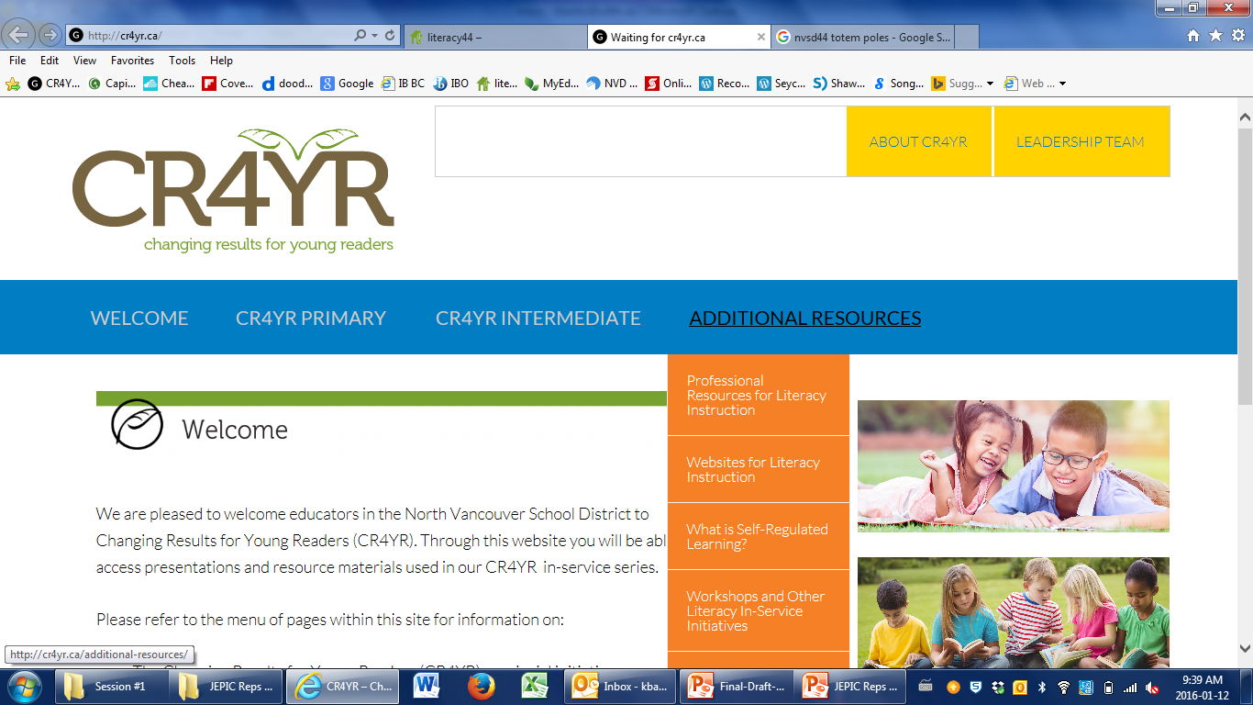


Literacy Resources
http://cr4yr.ca
http://literacy44.ca

Slide 9
Balanced Literacy Learning
Graphic from: University of Toronto “balanced literacy diet”www.litdiet.org How to Videos Motivation #56

Slide 10
Where to Start?
Emergent Reading
Session 1
Engagement
Print Work
Fluency
Session 2
COMPREHENSION
Fiction/ Literature
Nonfiction / Information
Plot / Setting
Themes / Ideas
Main Idea
Vocabulary
Vocab / Fig. Lang.
Character
Key Details
Text Features

Slide 11
Reading in Intermediate
“Reading is not a subject that is taught only in the primary grades, but a subject that needs to continue to be taught throughout elementary school and beyond.”
(Gear, 2006)
Notes:
Kammi
Multiple literacies, big ideas and curricular competencies, comprehension continium, content area reading-- research—
Research, actual strategies, link lit 44, making thinking visible, indigenizing the curriculum

Slide 12
Comprehension in Intermediate
How is comprehension in Intermediate grades different than in Primary grades?

Slide 13
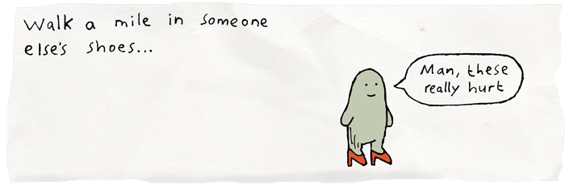
Walking a Mile in their Shoes
www.plickers.com

Slide 14
What is Comprehension?
“The goal of comprehension is to acquire and actively use knowledge”
(Harvey & Daniels, 2009)

Slide 15
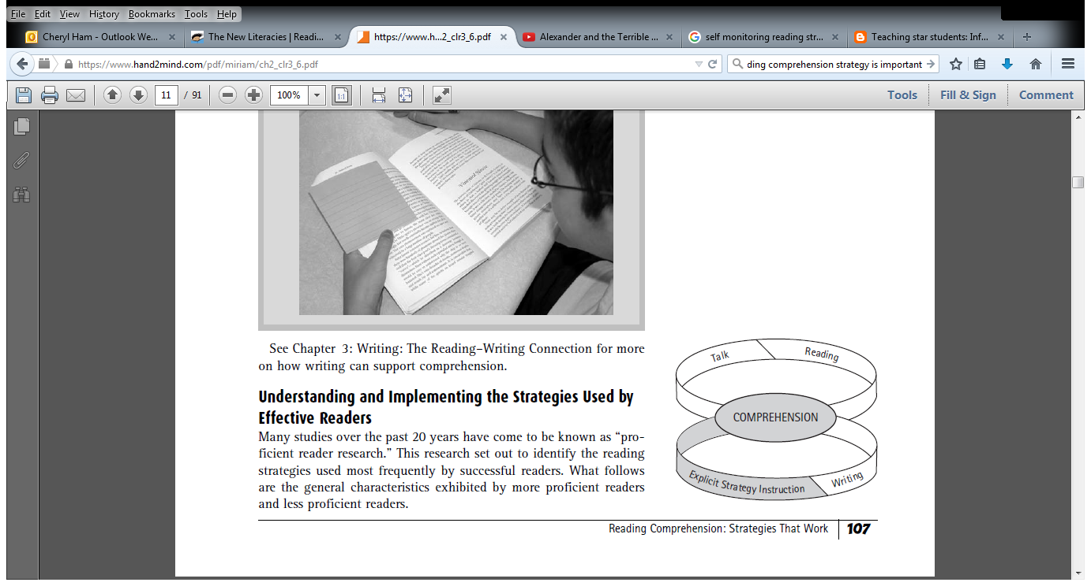
Growing Great Readers
Reading Principle
Response Principle
Explicit Instruction Principle

Slide 16
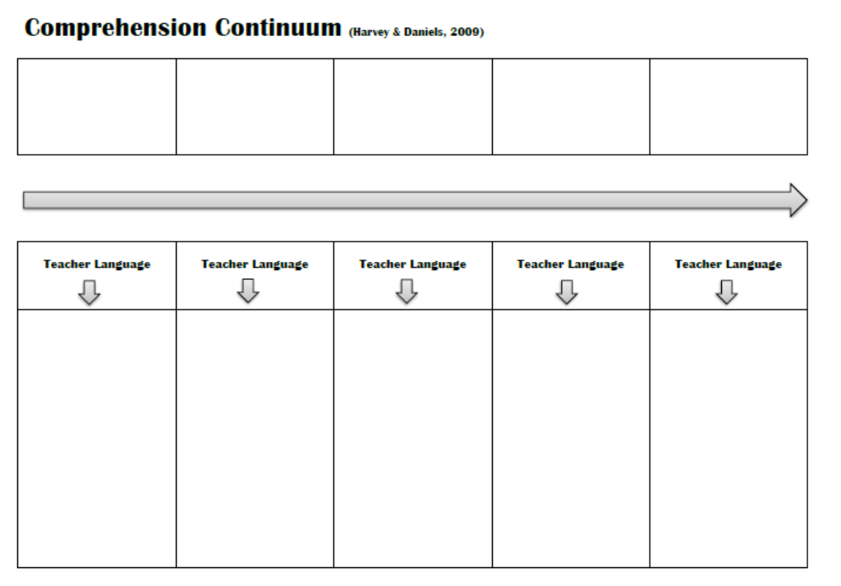
Sorting Activity
Sort headings from
low level
→
high level
thinking

Slide 17

Comprehension Continuum

Slide 18

Comprehension Continuum

Slide 19
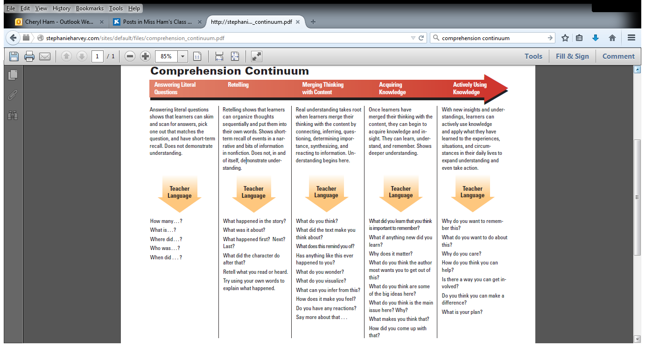
Comprehension Continuum
Notes:
Jessica – to explain
arrow of contiuum

Slide 20
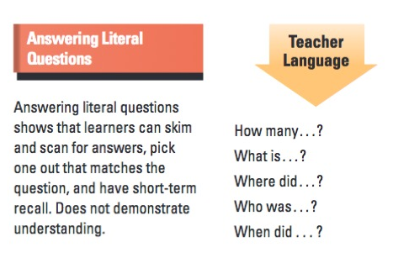
Comprehension Continuum

Slide 21
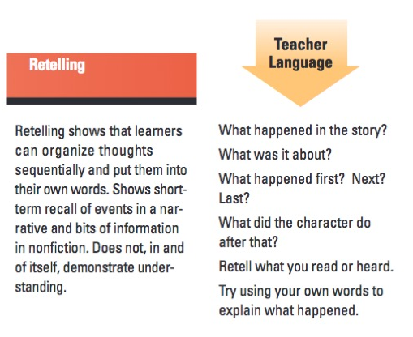
Comprehension Continuum

Slide 22
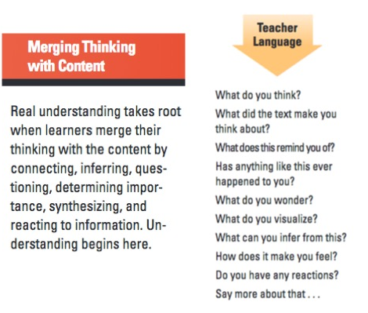
Comprehension Continuum

Slide 23
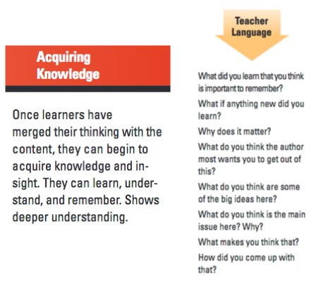
Comprehension Continuum

Slide 24
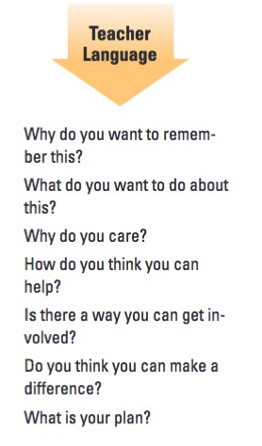
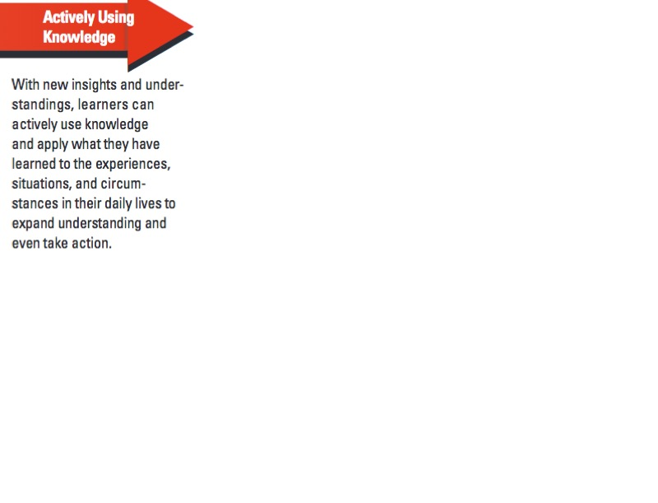
Comprehension Continuum

Slide 25
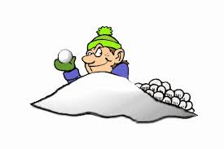
Comprehension Strategies
What strategies do students need to use to comprehend something?
Notes:
Kammi explain the research on why we choose these 4…

Slide 26

Comprehension Strategies
As a table group, rank your top three strategies.
Notes:
Kammi explain the research on why we choose these 4…

Slide 27


Slide 28
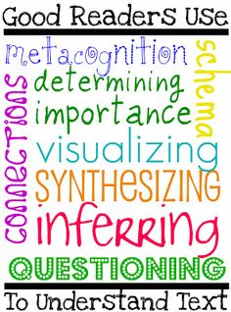
Comprehension Strategies
Self-Regulating
Summarizing
Making Meaningful Connections
Inferring
Notes:
Kammi explain the research on why we choose these 4…

Slide 29
Comprehension Strategies
WHY FOUR STRATEGIES?
“Less is more” philosophy that promotes a “depth of understanding of a few powerful, transferable strategies rather than exposure to a breadth of strategies that become mind boggling and disconnected.”
(Lanning, 2009)
Notes:
Kammi explain the research on why we choose these 4…

Slide 30
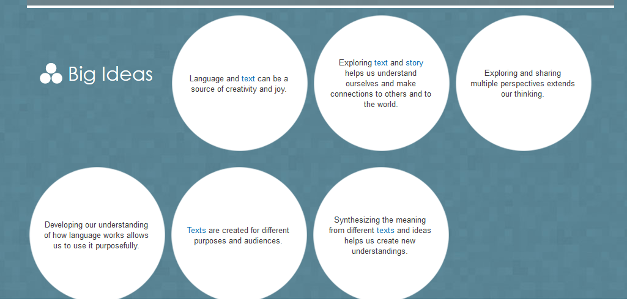
Curriculum Connections
Notes:
Kammi explain the research on why we choose these 4…

Slide 31
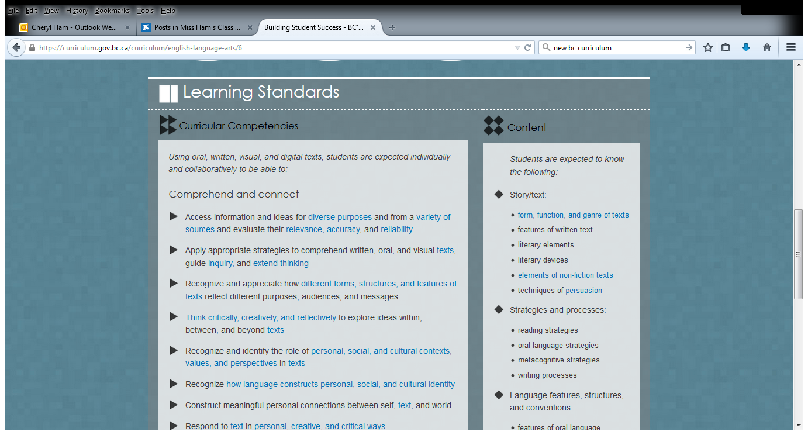
Curriculum Connections
Notes:
Kammi explain the research on why we choose these 4…

Slide 32
The Think Aloud
“Much of what happens with texts in classrooms gives students the mistaken impression that reading comprehension happens by magic. To begin to build a repertoire of activities for reading comprehension, students need to have the reading process demystified. The need to see what happens inside the mind of a proficient reader, someone who is willing to make the invisible visible by externalizing his or her mental activity.”
(Greenleaf, Murphy, & Schoenbach, 2012)

Slide 33
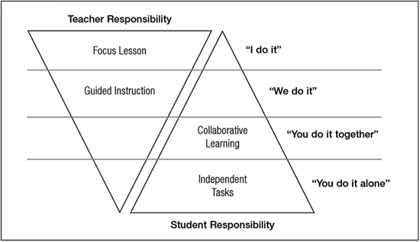
Gradual Release of Responsibility
Notes:
connect to compre continuum

Slide 34
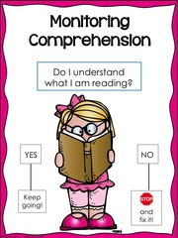
Self Regulating
Notes:
Definition:
Awareness of self, task, strategies
Purpose of reading
Re-reading and reading ahead
-predicting, clarifying,
-adjusting reading rate
Cross checking multiple sources of information

Slide 35
Self Regulating
“When self regulating, a reader is continuously checking his or her reading to make sure it makes sense, and is using a variety of ‘fix up’ skills when it does not make sense.”
(Lanning, 2009)

Slide 36
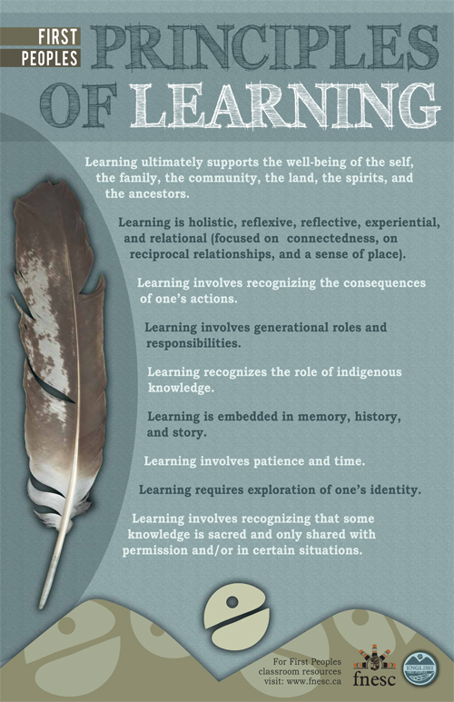

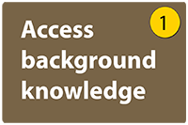
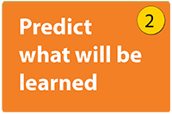
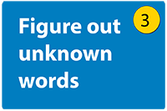
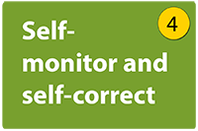
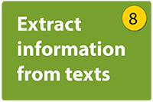
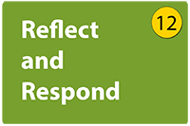
Self Regulating
Literacy 44
Learning is holistic, reflexive, reflective, experiential and relational
Learning involves recognizing the consequences of one’s actions.
Learning involves patience and time
Learning requires exploration of one’s identity

Slide 37
Questions That Drive Thinking
This reminds me of…
I’m predicting that…
From my background knowledge I know….
Should/shouldn’t there be…
I can just picture…
I’m a little confused here…
I’m not sure of….
The key idea here is…
This is worth remembering, I think …
I think that the author …
I need to go back and reread that part…
Remember when it said …

Slide 38
Self-Monitoring
When students self-monitor they need to:
be aware when meaning breaks down
identify what it is they do not understand (word, sentence, paragraph)
use appropriate strategies to “fix-up”, to restore meaning.

Slide 39




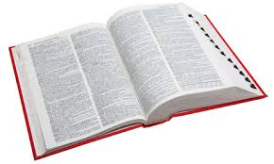


Some Fix- Up Strategies
Slow Down
Reread
Use aids (maps, graphs, charts)
Continue reading to see if the next part makes sense
Use the glossary or dictionary
Ask another student
Ask an adult
Notes:
When they understand what they are reading, they are clicking along when they do not understand , they have hit a clunk. It is important to teach students what to do when they hit a clunk, especially in reading in the content areas
rewrite

Slide 40
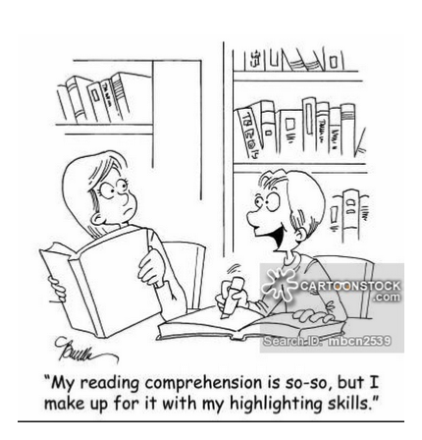
Self Regulating

Slide 41
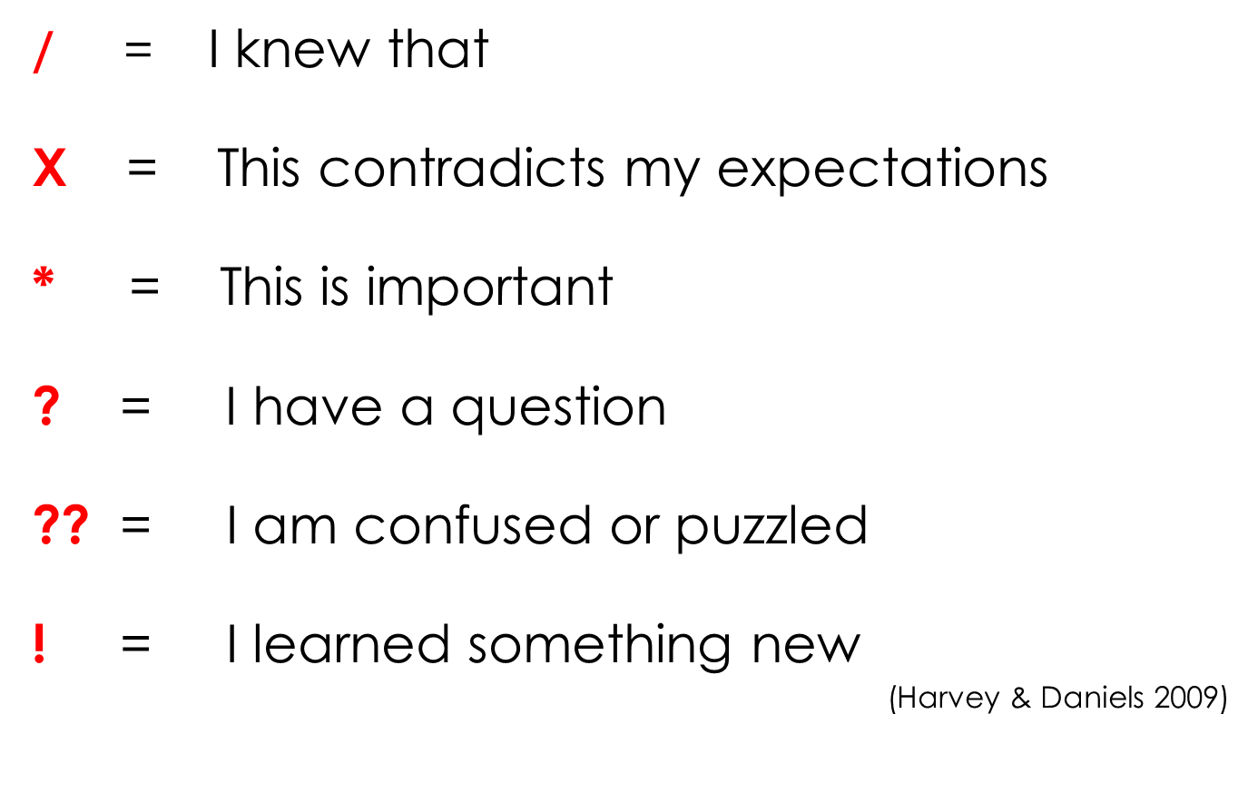
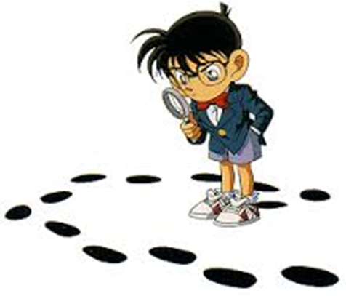
Leaving Tracks of Thinking

Slide 42
Self Regulating

Slide 43
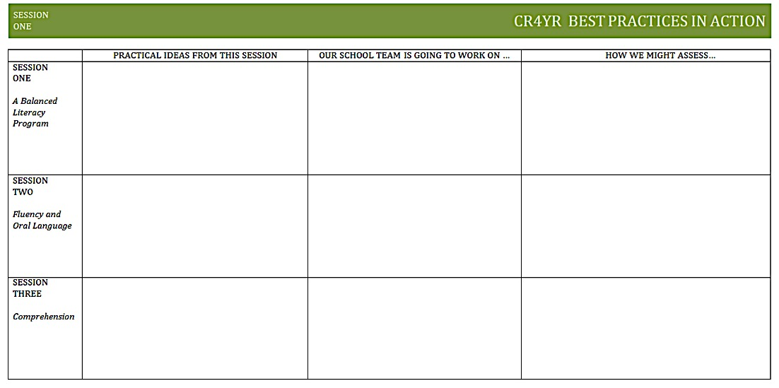
School Action Plan
Notes:
Remind of graphic organizer to help guide
Encourage you to
Part of the practical ideas might be resources… CR4YR and Lit44 websites

Slide 44
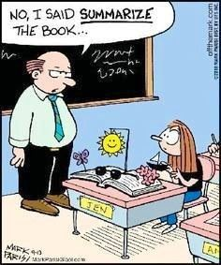
Summarizing
Notes:
Definition:
-main idea
-important information and details
-sequence
-identifying genre
-paraphrasing
Synthesizing is one of the big ideas in Grade 6/7 curriculum

Slide 45
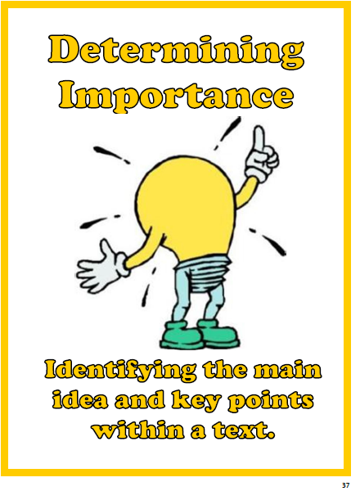
Summarizing

Slide 46
Summarizing
“Summarizing requires the reader to identify, paraphrase, and integrate important text information. Summarizing may occur across different lengths of text; it is a strategy in which a reader is constantly synthesizing the important ideas in text.”
(Lanning, 2009)

Slide 47


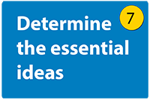
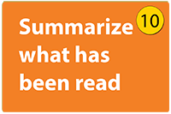
Summarizing
LIT 44
Learning is embedded in memory, history, and story
Learning involves recognizing that some knowledge is sacred and only shared with permission and/or in certain situations

Slide 48
Summarizing
What You Want to Do:
Pull out the main ideas
Focus on key details
Use key words and phrases
Break down larger ideas
Be clear and concise – only include enough to get the gist of the article

Slide 49
Questions That Drive Thinking
What’s important here …
What matters to me …
One thing we should notice …
I want to remember …
It’s interesting that …
The most important facts are …
I think the big idea / main point is …
This is important

Slide 50
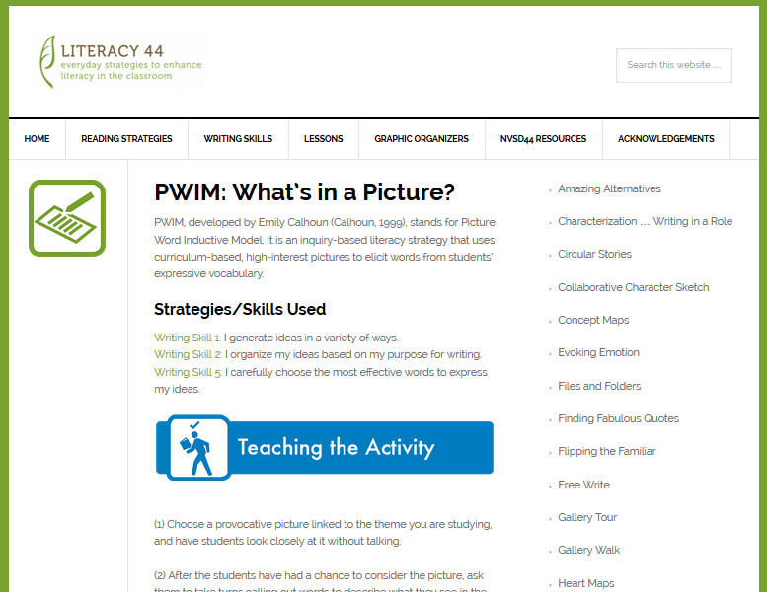
Summarizing
Notes:
Picture for PWIM

Slide 51
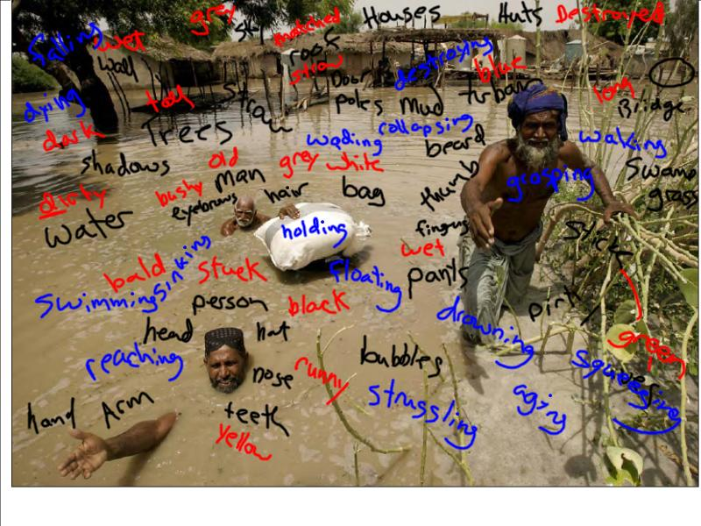
Summarizing

Slide 52
Summarizing
Some ideas:
Crossing out strategy
Tweet your response
Summarizing on a budget

Slide 53
Summarizing

Slide 54
School Action Plan
Notes:
Remind of graphic organizer to help guide
Encourage you to
Part of the practical ideas might be resources… CR4YR and Lit44 websites

Slide 55
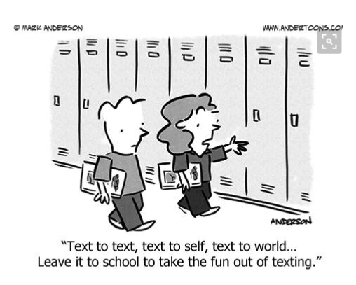
Making Connections

Slide 56
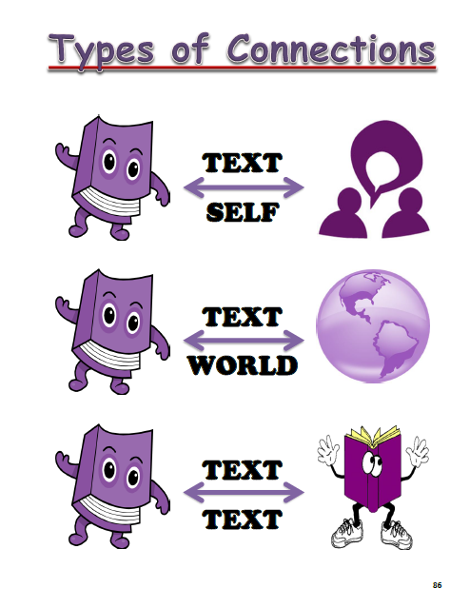
Meaningful Connections

Slide 57
Meaningful Connections
“Readers make connections with text in a variety of ways. Connections…are made by bringing ones’ background knowledge to the information in the text. When creating meaningful connections, a reader is relating his or her previous experiences, knowledge, and/or emotions to the ideas presented in the text.”
(Lanning, 2009)

Slide 58

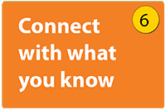
Making Connections
Literacy 44

Slide 59
Questions That Drive Thinking
This reminds me of …
I know another …
I’ve read another …
I’ve watched another …
I remember when …
This part is like ..
The character is like …
This is similar to / different from …
I can relate to this character because …
I have had a similar experience when …

Slide 60
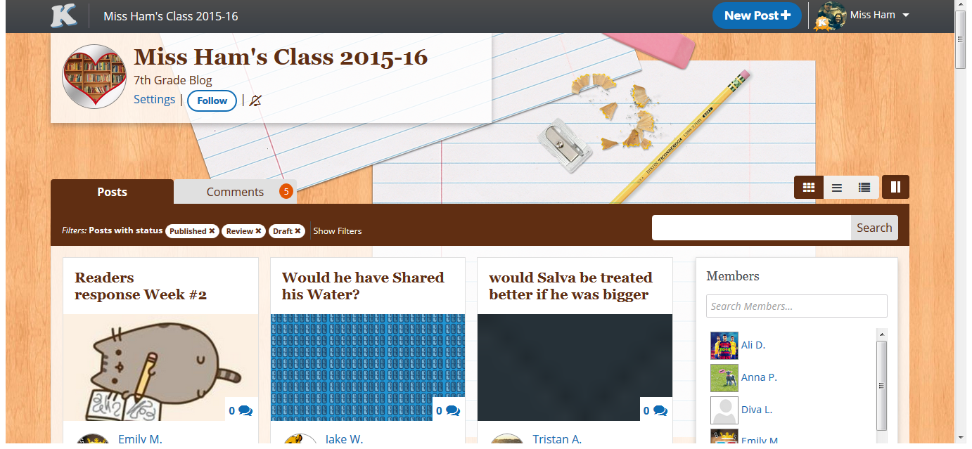
Reading Response Idea

Slide 61

Making Connections
As you listen to the story, record any connections that you have.
Notes:
…

Slide 62

Making Connections
Chalk Talk
(Chalk Talk is a silent conversation on paper)
In your tables, record your connections on your paper. Read what others have written and add on or connect to other’s thoughts.

Slide 63
Making Connections

Slide 64
School Action Plan
Notes:
Jessica
Remind of graphic organizer to help guide
Encourage you to
Part of the practical ideas might be resources… CR4YR and Lit44 websites

Slide 65
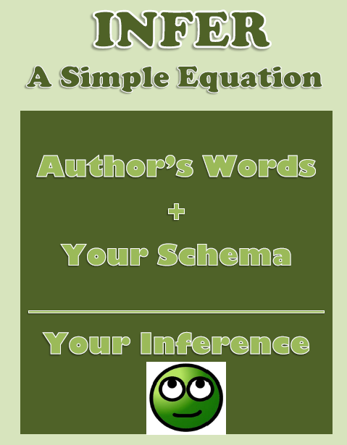
Inferring

Slide 66
Inferring
“Inferring is an essential reading strategy, as it not only facilitates comprehension, but it also enhances the reader’s enjoyment of the text as new perspectives are discovered.”
(Lanning, 2009)

Slide 67


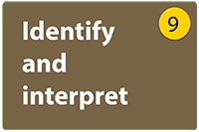
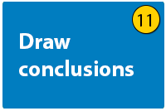
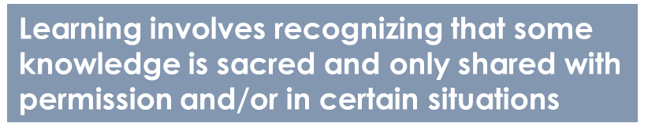
Inferring
Literacy 44
Learning is embedded in memory, history, and story

Slide 68
Questions That Drive Thinking
This makes me think that …
I think that the author is really saying …
At first I thought … but now I think …
This clue leads to believe that …
After reading this chapter / page, I suspect …
I think I understand what the author meant when he or she wrote …

Slide 69

Inferring
Look in the bags at your table…. Make some inferences as to who this suitcase belongs to and/or where this person is going (or has been)
Complete the
Claim, Support, Question

Slide 70
Inferring

Slide 71
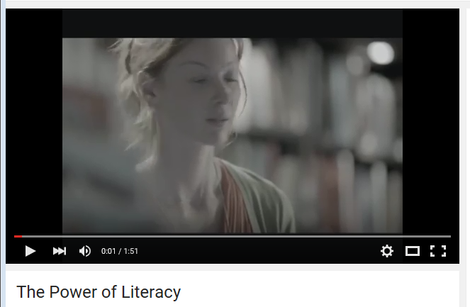
The Power of Reading
https://www.youtube.com/watch?v=83DO0POacCE

Slide 72
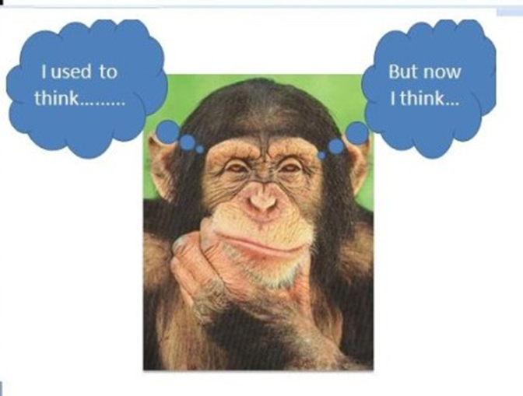
Reflect on the CR4YR Series

Slide 73

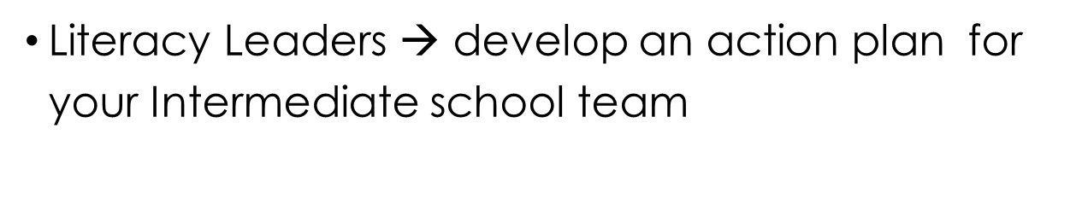
School Action Plan

Slide 74
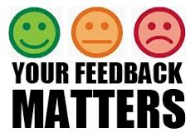
Series Feedback
Complete the third Survey
email Kathleen Barter

Slide 75
CR4YR 2016 Leadership Team
      Kammi Clark
      Ann Copp
      Jenny Crowe
      Jillian Gordon
      Cheryl Ham
      Johneen Harris
      Jessica Johnson
      Heather Myhre
      Nicky Paiuk
      Nadya Rickard
      Darlene Sulis
      Stephanie Weller
Thank you
Notes:
INTRODUCE TEAM HERE.

