Slide 1
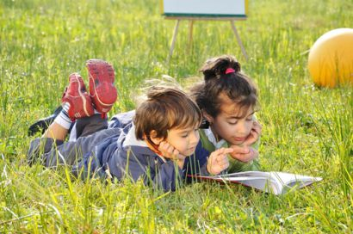
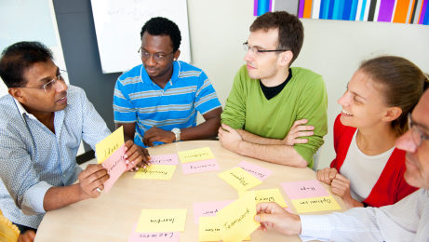
CR4YR
2015
Session 4
Putting Research Into Action

Slide 2



CR4YR Session 4
Big Ideas
Strategic assessment informs teacher as learner and develops the student as his/her own teacher.
Learning requires exploration of one’s identity. Formative assessment and teacher feedback shape the identity and mindset of learners.
Learning to read requires a balanced literacy program that includes direct, strategic instruction of all components in a flexible, responsive environment.
Learning and change are social processes. Collaborating with colleagues to meet the needs of a diverse group of learners will result in positive growth for all.
Notes:
8:30

Slide 3

Learning Targets
Session #4
*I will have a better understanding of the tools and practice of assessment and how feedback influences student growth and identity.
*I will have a better understanding of collaboration and co-teaching.
*Through the process of inquiry I will identify and further develop an element of my balanced reading program.
*I will leave with a question and a plan to examine that question that includes seeking support and feedback… because I am a learner.
Notes:
8:35 Time to reflect and unpack learning so far. Time to make plans for personal and collaborative action. One or two new ideas and research to examine.

Slide 4

One small change in practice
http://globalnews.ca/video/1690463/heart-attacks-and-oxygen-connection
Take 5 minutes
Discuss in table groups how this news clip connects to the examination of our practice as literacy teachers.
Notes:
8:40 First 3 sessions gave us time to review the foundational components of a balanced reading program; ask what’s going on for struggling readers; develop an understanding of First People’s Principles of Learning; examine self-regulated learning; reflect on our practice; ponder questions and begin an inquiry…. And finally COLLABORATE and share ideas.
The news clip 2:14 ONE SMALL CHANGE go to next slide

Slide 5
Session 2 and 3 Touchback
Learning to read is a developmental process. Struggling readers require explicit teaching of the core components of reading.
Role of oral language
Phonemic Development
Phonics
Concepts of Print
Sight Word Reading
Automaticity
Vocabulary Comprehension
Passage Comprehension
Oral Language (retell, book talks
Fluency
Catching Readers… a comprehensive literacy framework
Refer to your Case Study student and reflect on questions and changes in practice
Bring Something / Take Something
Notes:
8:50 “The plan is to design reading instruction for maximum benefit for all readers. We can’t do it all. BALANCE
Balanced for all learners in terms of their needs. For example if a struggling reader is receiving additional 1:1 support this must typically not occur during another literacy instruction time (read aloud, shared reading…)
Bring Something / Take Something - bring something new to your practice… take something away.
Rework a piece of your reading program what would it be and how would you do it?

Slide 6
Instructional Context | Text Choice/Level/ Purpose | Accessibility | Who does the work?
Read Aloud | A stretch Model model model. Most kids couldn’t read this on their own | Challenging | The teacher – and moves to co-construct understanding with the kids
Shared Reading | Just beyond most kids. Model and guided practice | Somewhat challenging for many | Read together and think together
Guided Reading/Small Group Instruction | Just right books Guided and some independent practice | Matched to individual students | The student reads and thinks with side by side guidance
Independent Reading | Wide range of choice Independent application | With ‘productive effort’ and stamina, level can vary | The student, reading with purpose to understand
Literacy Think Tank http://www.burkinsandyaris.com/blog/

Slide 7
Response to Intervention
The practice of providing high-quality instruction and intervention matched to the students need, monitoring progress frequently to make decisions about changes in instruction and applying child response data to educational decisions
-National Association of State Directions of Special Education
Notes:
9:00 am

Slide 8
RTI - Literacy Collaboration
Progress Monitoring
Progress Monitoring
Progress Monitoring
Progress Monitoring
Notes:
9:05

Slide 9
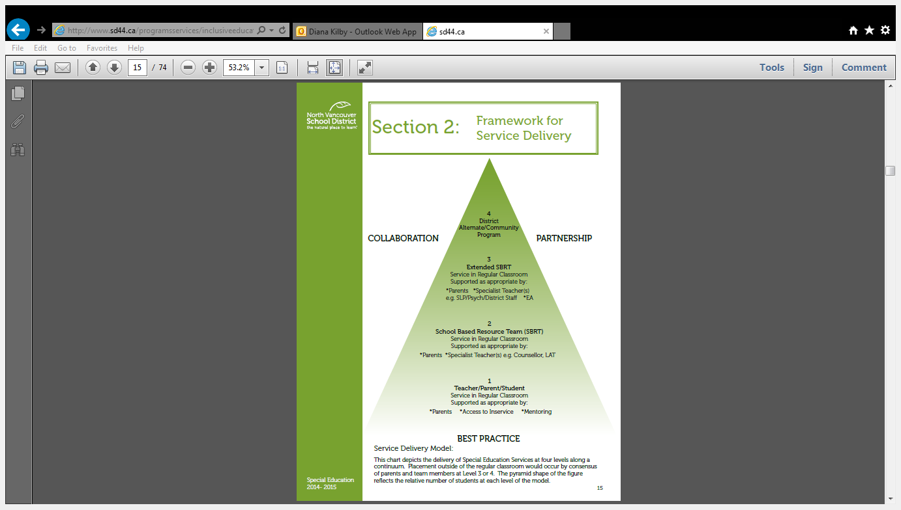
Notes:
9:10

Slide 10
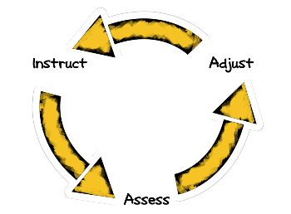
Assessment Drives Instruction
Notes:
9:30

Slide 11
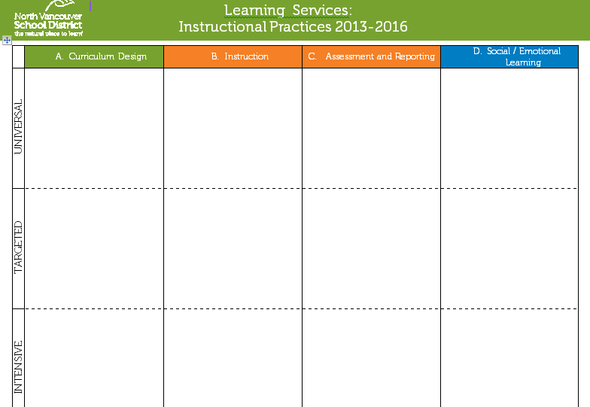
Observations
Student-Teacher Conferences
Classroom Reading Assessment
Running Record
RAD
DRA/PM Benchmark
TOPA*
CTBS
DIBELS
Running Record
DRA
Jerry Johns
CTBS
Running Record
Level B (e.g. WJ)
SLP/Psych ED

Slide 12

Team Conversations
How does assessment drive your literacy instruction in your classroom?
Discuss ways in which you differentiate reading instruction for the diverse learners in your classroom?
Notes:
9:25 Conversations and share out

Slide 13
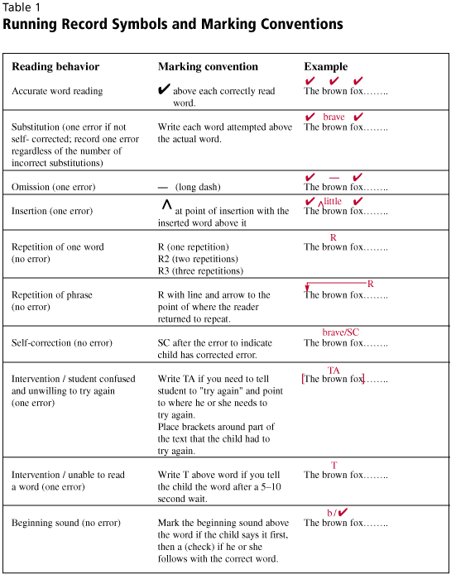

Notes:
9:40 What is a running record? One of the most beneficial assessments that a classroom teacher can do with a student.

Slide 14
Running Record Demonstration
http://www.youtube.com/watch?v=ZO-4OYiJiUA
How did the teacher introduce this assessment?
What kind of positive feedback did she give to the student?
What suggestions did she give him to move his learning forward?
Practice doing the Running Record for this student
What support/instruction does he need next?
Notes:
9:45 – 10:00 Goal = fluency (accuracy, expression, understanding)
Have the teachers do their own assessment – what feedback
Positive – smooth, sounds like talking, punctuation
Feedback – headlights? Does that make sense (little correction).
This will seque into ilona’s section on Feedback.

Slide 15

Other Formative Assessments
Summaries and Reflections Students stop and reflect, make sense of what they have heard or read, derive personal meaning from their learning experiences, and/or increase their metacognitive skills.
Lists, Charts, and Graphic Organizers Students will organize information, make connections, and note relationships through the use of various graphic organizers.
Visual Representations of Information Students will use both words and pictures to make connections and increase memory, facilitating retrieval of information later on. This "dual coding" helps teachers address classroom diversity, preferences in learning style, and different ways of "knowing.”
Collaborative Activities Students have the opportunity to move and/or communicate with others as they develop and demonstrate their understanding of concepts.
Notes:
10:00

Slide 16


Slide 17
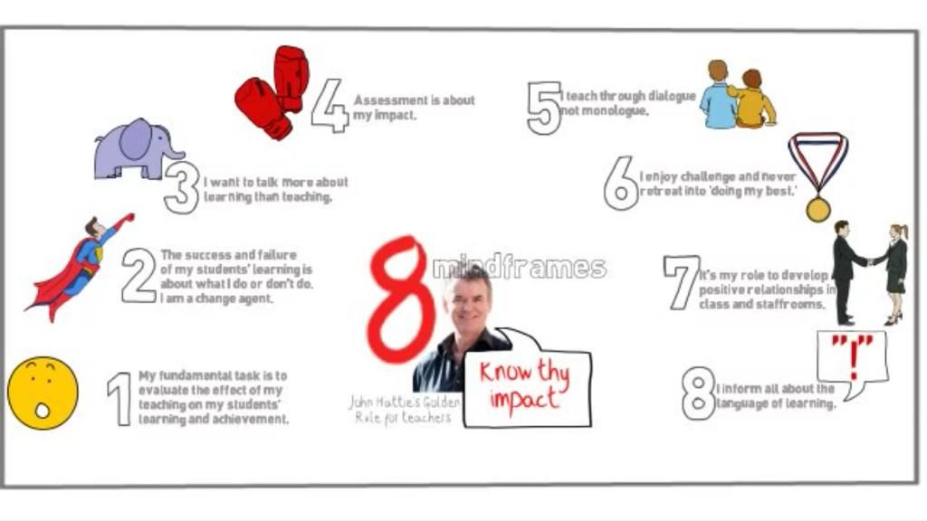
Brain and Body Break
https://www.youtube.com/watch?v=6xpcXobZF1k
Notes:
10:00 break 3:30 sec run through video

Slide 18
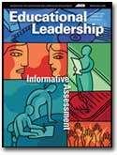
Feedback
When implemented well, formative assessment can effectively double the speed of student learning (William, 2007)
To be legitimate the assessment must inform instruction.
Most research has focused on short- and medium-cycle formative assessment, in which the length of the feedback cycle was minutes, hours, or days.
Dylan William (2008)
Notes:
10:15 Include student in the assessment process.
Opportunities to go back.
Much research on the Feedback and supporting students THINKING and application of STRATEGIES when they encounter something difficult. Defines a ‘self-regulated’ learner.
PRE READ ARTICLE _- - Effective Feedback (Dylan William) Changing Classroom Practice… MEET REGULARLY
To learn deeply enough to change daily practice (underlying principles) takes months if not years… takes a YEAR to A CAREER
**clarify and share learning intentions and criteria for success
**engineer effective classroom discussions, questions, learning tasks. Teachers need to use effective questioning techniques
**Provide feedback that moves learners forward
**Activate students as the owners of their own learning
**Encourage students to be instructional resources for one another – peer assessment
Slave to praise…

Slide 19
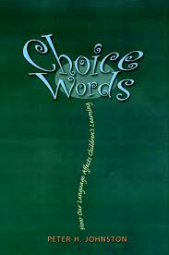
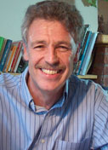
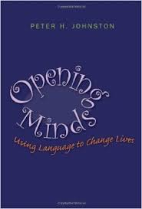
Choice Words
How our Language Affects Children’s Learning
…our language choices have serious consequences for children’s learning and for who they become as individuals and as a community.
…the language we choose in our teaching changes the worlds children inhabit now and those they will build in the future.
-Peter H. Johnston, 2012
Opening Minds
Using Language to Change Lives
Notes:
10:20 Grew up in New Zealand and taught Elementary school there. Earned PhD at the Centre for the Study of Reading at U of Illinois
Another book : “Knowing Literacy” Assessment in Literacy
Building Identity
Our oral language (FEEDBACK) is often filled with value and judgement (praise).
Some UNINTENTIONAL … holding student back to read for 2 minutes.
Peter H. Johnston looks at Teacher language and feedback that demonstrates, leads to and expects a
DYNAMIC LEARNING FRAME (critical thinking) vs FIXED PERFORMANCE FRAME (limited thinking)

Slide 20


Statements and Questions as Feedback
Our assessment practices and feedback will shape a child’s identity:
This took a lot of effort to complete. I can tell.
I wonder if, as a reader, you’re ready for this.
You are so clever!
I bet you’re proud of yourself.
Great job. Nice work.
What are you doing as a writer today?
That was a smart way to do this.
What have you learned most recently as a reader?
That was inappropriate.
That’s not like you. Is there something you can do differently?
Notes:
10:30
Examples of Teacher feedback… formative assessment. All are unpacked and discussed in CHOICE WORDS. That’s not like you… points out a social transgression with acknowledgment from you that this is an exception. When you praise kids on ability it makes them focus on looking good rather than on learning.
In what ways will these statements and questions inform identity, engage active thinking and strategy use…metacognition?

Slide 21
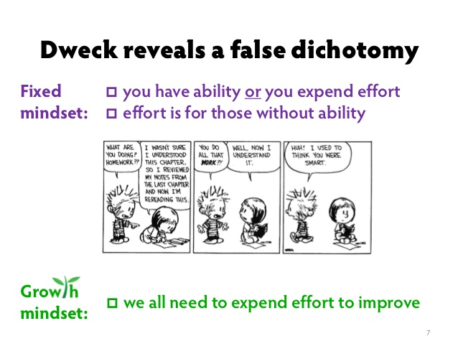
Notes:
10:35 Closely connected
Professor of psychology at Stanford university.
connected to the Strategic, Self Regulated Learning.

Slide 22
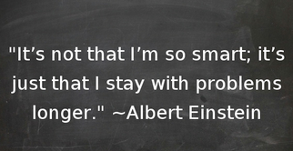
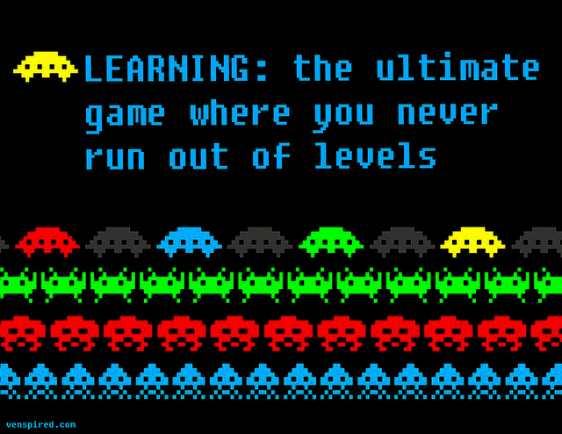
I View
Mistakes
As
Opportunities
It looks like we have a
“Probletunity”
https://www.youtube.com/watch?v=TTXrV0_3UjY
http://youtu.be/kXhbtCcmsyQ
http://youtu.be/wh0OS4MrN3E
Notes:
10:40 Design a classroom poster that supports a growth mindset, where mistakes are welcomed,
“I view mistakes as opportunities” “This looks like a probletunity” Carol Dweck video 3:25 The Effects of PRAISE on Mindset
2nd Video is Khan Academy You can Learn Anything Movement 3:30 mins
3rd is Stephanie Fryberg Research on Cultural Framing for Mindset intervention “when you grow your brain you will be able to help your family, your community, and your land” Reference to the First Peoples Principles of Learning on Tulalip Reserve 570 students k-5
There is an additional 48 minute video link on the blog that gives a much more in depth look at Dwecks research and a fascinating connection to the Tulailip Reserve school
It was also noted in the Dylan William article that Teacher Learning communities should have 8-10 people discussing research and practice so that there is room for DIFFERENCES OF OPINION.

Slide 23
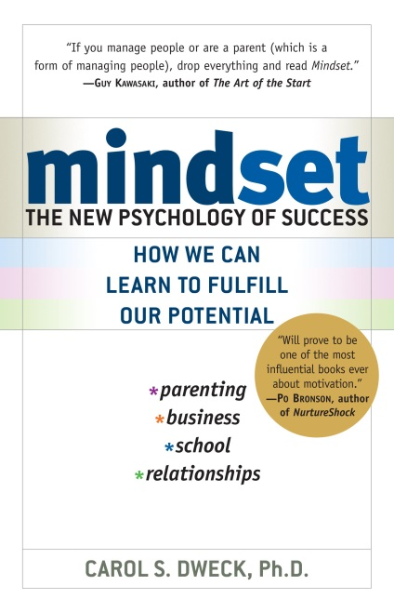
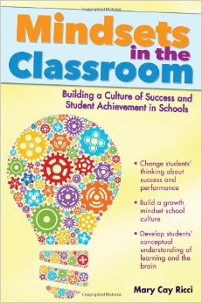
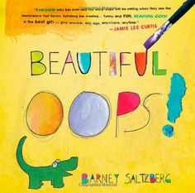
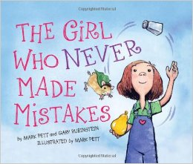

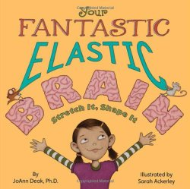
Mindsets Can Change
The Growth Mindset Is Teachable
Notes:
10:45 Viewing mistakes as opportunities
Becoming strategic in the face of unexpected or undesirable situations
Using the work… YET “I don’t know this…YET
Teaching new vocabulary: Tenacious, tenacity, perseverance, effort, practice (not work), concentration

Slide 24

Collaboration
col·lab·o·ra·tion kəˌlabəˈrāSH(ə)n/
noun: collaboration; plural noun: collaborations
1. the action of working with someone to produce or create something.
Notes:
Can take on various forms… 2 people ….to several people. Collaboration leads to Learning Communities…next slide

Slide 25
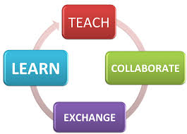
Learning Communities
Starting with formative assessment
“Like minded” individuals
Regular meetings
Enough members to welcome diversity
Similar teaching assignments
Modest action plans
Notes:
Perhaps refer back to the “fearless Inventory” for a place to start ?

Slide 26

Your Task:
To create an action plan around strategic teaching in such a way that it will have an impact on student learning and success with reading.
  What is one thing that you will find easy to change?
  What is one thing that you will need support with?
  What other changes can you make?
  What will you do differently to implement these changes?
See p. 5 Changing Classroom Practice

Slide 27

Now What……
Student Case Study – Follow Up
Complete this page based on your table discussions

Slide 28

Finally…..
Find two or three other people in the room
Talk about your learning/understandings/big ideas/successes from the CR4YR series
Decide on the title of a song that best represents your conversation
Notes:
Find two or three other people in the room
Talk about your learning/understandings/big ideas/successes from the CR4YR series (each person gets a few minutes to speak)
Decide on the title of a song that best represents your conversation
Sharing out (participants can read or sing their song title + one line from the song)
The activity only takes about 10 minutes. It’s active and FUN. Would be a great way to end the series!

Slide 29

Thank you so much!! Please leave FEEDBACK forms with presenters

Slide 30
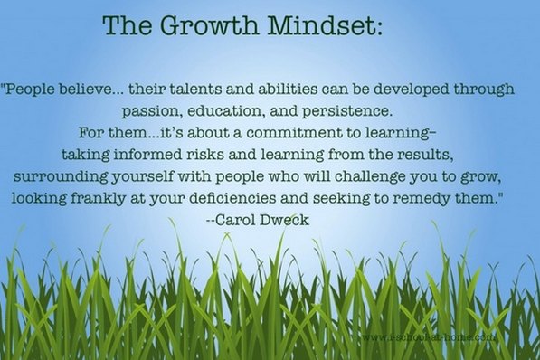
Notes:
THANKS YOU and DOOR PRIZE!!
Session evaluation

