Slide 1
Changing Results for
Young Readers
Intermediate Series
January 2016
Notes:
8:30 am

Slide 2
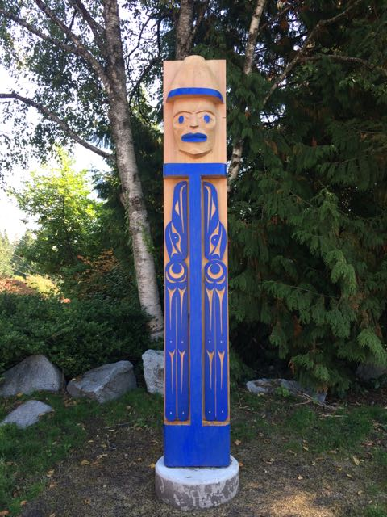
Traditional Territory Acknowledgement
Notes:
Johneen & Stephanie
North Vancouver School District – Traditional Territory Acknowledgment
I would like to start by acknowledging and thanking the Coast Salish people whose traditional territory North Vancouver School District resides on. I express our gratitude to the Squamish Nation and Tsleil Waututh Nation and we value the opportunity to share our knowledge, stories, and educational experiences on this traditional territory.
NVSD - Reconnaissance du territoire traditionnel
J’aimerais reconnaître et remercier les peuples autochtones de la côte Salish dont leur territoire traditionnel est le siège de la Commission scolaire de Vancouver Nord. Nous exprimons notre gratitude envers les Nations Squamish et Tsleil-Waututh. Nous apprécions l’occasion d’apprendre, de vivre et de partager des expériences éducatives sur ce territoire traditionnel.

Slide 3
The Leadership Team
Ann Copp
Cheryl Ham
Darlene Sulis
Heather Myhre
Jenny Crowe
Jessica Johnson
Jillian Gordon
Johneen Harris
Kammi Clark
Nadya Rickard
Nicky Paiuk
Stéphanie Weller
Notes:
Kathleen

Slide 4
CR4YR Project Goals - 2016
Provide strategies/ideas for intervention and support for struggling readers
Continue with an inclusive model of universal, targeted and intensive interventions for intermediate students who struggle with reading
Focus on establishing literacy learning communities in the school/FOS
Integrate the Literacy44 website into the CR4YR series
Notes:
Kathleen
Needs updating from the discussion Mon. Oct 26

Slide 5
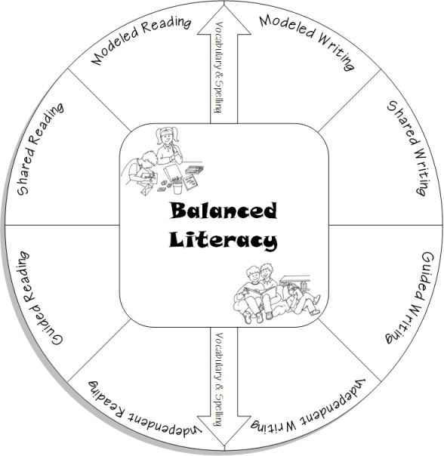
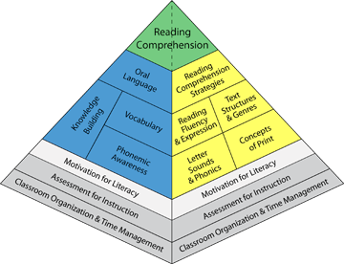
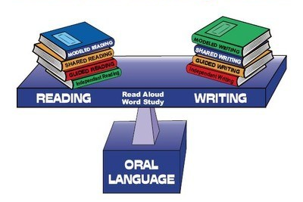
Balanced Literacy
As Literacy Leaders, think about…
“In what ways am I already helping my students to learn language, to learn about language, to learn through language, and to use language to critique?”
(Vasquez, 2003)
Notes:
Nicky

Slide 6
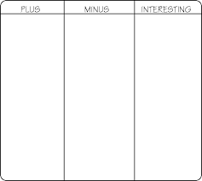
Gallery Walk
Reflections
on last week’s thoughts…

Slide 7
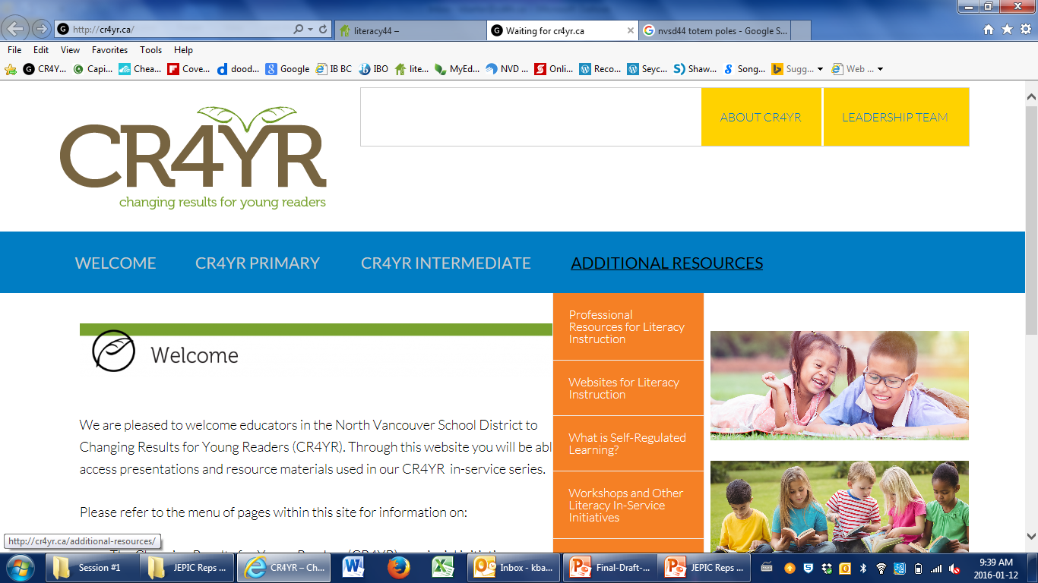
Literacy Resources
http://cr4yr.ca/
http://literacy44.ca
Notes:
Jillian
https://cr4yrintermediate.wordpress.com
literacy44.ca
CR4YR has handouts and information about each session
Literacy44 has the resources from Reading 44 and Writing 44, some may have had presentations about literacy44 at schools
All handouts at today’s sessions are available online… handouts for other sections
Website links
Links to click from slide
Morning of… browser windows minimized and ready to pull up

Slide 8
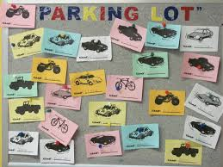
Parking Lot
Notes:
Jillian
https://cr4yrintermediate.wordpress.com
literacy44.ca
CR4YR has handouts and information about each session
Literacy44 has the resources from Reading 44 and Writing 44, some may have had presentations about literacy44 at schools
All handouts at today’s sessions are available online… handouts for other sections
Website links
Links to click from slide
Morning of… browser windows minimized and ready to pull up

Slide 9
Review Session #1
To enhance Literacy Leader and teacher capacity in literacy instruction
To understand the intermediate reader
To explore literacy resources and
strategies for the intermediate
classroom
University of Toronto “balanced literacy diet”www.litdiet.org

Slide 10
Learning Targets Session #2
To understand the importance of fluency and oral language in the intermediate classroom
To explore and enhance strategies for teaching and assessing oral language and fluency

Slide 11
Principles of Learning
Notes:
.

Slide 12
What is Oral Language and Fluency?
Instructional Strategy:
Think – Pair – Share
What does oral language and/or fluency look like in an intermediate classroom?

Slide 13
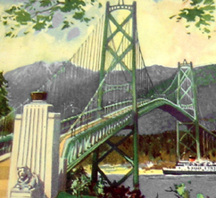
Oral Language: Foundation for Fluency Development
“Oral language is the foundation of literacy learning and is considered critical for successful literacy development Talk is the bridge that helps students make connections between what they know and what they are coming to know.”
David Booth

Slide 14
Literate Conversations
Children need to engage in true literate conversations – “the kind that people outside the classrooms engage in to make meaning of a text they care about.”
Richard Allington,
Educational Leadership, October, 2014

Slide 15
What is Fluency?
Accurate reading
Reading rate
Appropriate prosody
Understanding

Slide 16
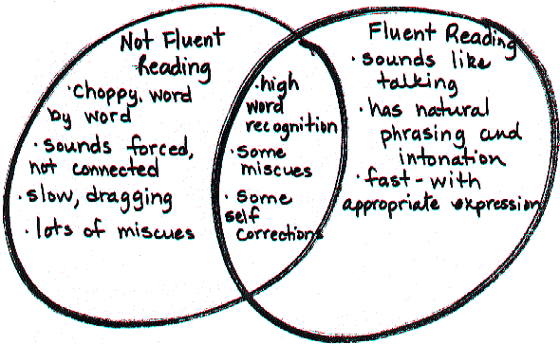
Reflect: I have a student who…
Reading Rockets

Slide 17
Reflect: I have a student who…
Instructional Strategy:
Popcorn
I have a student who….
Reading Rockets

Slide 18
Fluency: 3 Key Points
Assess for fluency
Teach fluency strategies
Explain why fluency helps students read

Slide 19
What To Look For…
Slow Reading Rate
Grade 4 – 140-170 WPM
Grade 5 – 170-195 WPM
Grade 6 – 195-220 WPM
Grade 7 – 215-245 WPM
Finger pointing as the student reads
Phrasing and intonation break-down
Student not self-correcting or monitoring for understanding

Slide 20
What To Look For
https://www.youtube.com/watch?v=ZO-4OYiJiUA

Slide 21
Reading Fluency
Instructional Strategy:
Jigsaw
Specialty Groups
In your role, how do you support reading fluency?

Slide 22
Reading Fluency
Instructional Strategy:
Jigsaw
School Groups
Using a growth mindset, how could you support the school community with fluency growth?

Slide 23
Supporting Oral Language Challenges
How do I know when to refer someone to SBRT for support?
LST
Speech and Language
What should I bring to an SBRT meeting?

Slide 24
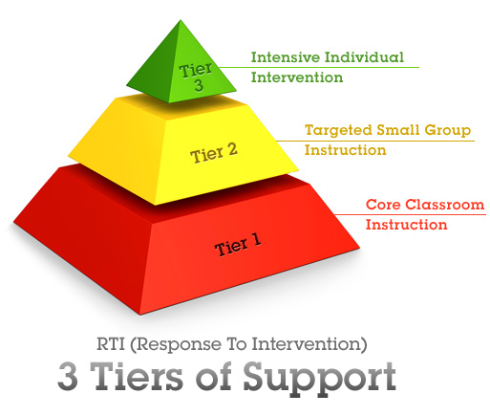
Levels of Support
“Successful learning for all students cannot be addressed by groups of professionals working in isolation. It
requires genuine collaboration at every level of the organization. This requires mutually
respectful learning among all those involved.”
(Inclusive Education Handbook, p. 4)

Slide 25
Intensive Support
Repeated Readings
Choosing the right books
Teaching the fastest way to read words

Slide 26
Intensive Support
What Works Clearinghouse: Read Naturally
http://ies.ed.gov/ncee/wwc/findwhatworks.aspx

Slide 27
Targeted Support
Find opportunities for repeated reading
Choral Reading
Partner Reading
Reader’s Theatre
Repeated Reading
Oral Story-Telling

Slide 28
Targeted Support
2. Target reading material for different groups in your class
Below level
At level
Above level
Well above level

Slide 29
Fluency Through:

Slide 30
Reader’s Theater
https://www.youtube.com/watch?v=P-Suvry_pw8

Slide 32
Instructional Strategy:
What Makes You Say That?
With fluency in mind, which part would you choose for your struggling reader or for your strong reader?

Slide 33
More Reader’s Theatre
The Great Cedar Tree

Slide 34
Le théâtre des lecteurs
Petit Théâtre
http://boomerangjeunesse.com/auteurs/martin-gougeon/
Dramaction – Textes à jouer et à télécharger gratuitement
http://www.dramaction.qc.ca/fr/textes-a-jouer-avec-vos-eleves/textes-a-jouer/
Jeunes Artistes
Open Format Creative Arts Competition presented by the CPF
http://bc-yk.cpf.ca/actvities/youth-activities/jeune-artiste/

Slide 35
Universal Support
Teach Fluency techniques:
Put words together in phrases (like you are talking)
Notice punctuation and match your voice to it
Change your voice to match the mood

Slide 36
Universal Support
Chunking/Phrasing:
Move beyond word-by-word reading by using phrasing

Slide 37
Universal Support
Look for Signals:
Help students become more aware of punctuation

Slide 38
Universal Support

Slide 39
Universal Support
Say it Like the Character:
Happy
Shocked
Tired
Confident
Upset
Excited
Sad

Slide 40
Universal Support
Say it Like the Character:
Yo! Yes!
(Chris Raschka)

Slide 41
Poetry Slam
https://www.youtube.com/watch?v=5FtpmU61RQE

Slide 42
Reader’s Theatre?
Instructional Strategy:
Compass Points
Reflect on the idea of using reader’s theatre or poetry in your classroom/practice to encourage fluency.

Slide 43
Poetry
Reading-Writing Connections: Literacy44.ca

Slide 44
Break

Slide 45
Mirror, Mirror
If I already like what I see, why make any changes?

Slide 46
My Goal for You

Slide 47
Literacy in the Intermediate Classroom
Is what I am already doing
getting me
the results
I want?

Slide 48
The Fast Food Strategy
Fold paper like a hot dog
Now fold hot dog into a hamburger
Number each box on the front
1, 2, 3, 4
Number each box on the back
5, 6, 7, 8

Slide 49
Box #1: Connect
How are the ideas and information presented thus far connected to what you already know and already do?
(Connect, Extend Challenge: Ritchhart, 2011)

Slide 50
Box #2: Extend
What new ideas did you get that extended or broadened your thinking in new directions?
(Connect, Extend Challenge: Ritchhart, 2011)

Slide 51
Box #3: Challenge
What challenges or puzzles have come up in your mind from the ideas and information presented?
(Connect, Extend Challenge: Ritchhart, 2011)

Slide 52
The Glass is Full

Slide 53
Research Sound Bite #1
A significant component of
reading instruction
needs to focus
on reading fluency
– a minimum of
120 minutes per week.

Slide 54
Research Sound Bite #2
Outside of school,
50% of grade 5 students
read four or less minutes
a day

Slide 55
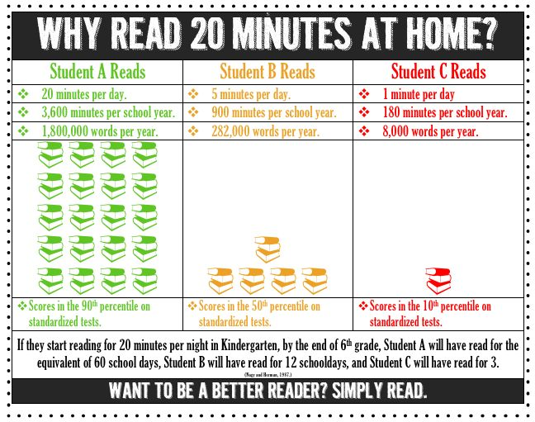

Slide 56
Vocabulary Acquisition through Independent Reading
Child A:
Does not read at home and does not use reading time at school to become a better reader. This child learns 1000 new words in a year.
Child B:
Does read during school but does not choose to read outside of school. Child B learns 3000 new words in a year.
Child C:
Loves reading! Spends time outside of school reading. Child C learns 6000 new words in a year.

Slide 57
Box #4: Creating Time for Independent Reading

Slide 58
Sustained Silent Reading
What is
really happening
during
silent reading…

Slide 59
Non Readers Have Mastered the Illusion of Reading
Eyes scan from left to right, top to bottom.
Pages turn when
the person beside
them turns his/her page.

Slide 60
Box #5: Helping Students Develop a Healthy Habit of Reading
Teachers need to provide the time to read but…
Readers need both the
skill and the will to read.

Slide 61
Developing the Will to Read
To be engaged readers, students must recognize the value of reading and their own potential as readers.
Motivation is essential to becoming a proficient and lifelong reader.
Non-effective readers see reading as an entirely school-based activity with no impact on their present or future lives.

Slide 62
Student Motivation for Reading
Students are motivated when they can do the following:
Choose their own books to read
Read series books
Talk about books with others

Slide 63
Developing the Habit of Reading
Children Need:
Books that are at an appropriate level for their independent practice, and
Extended blocks of time to read books during school hours.
A + B = C

Slide 64
Box #6: What Are You Going to Try?
Promoting Fluency in the Intermediate Classroom
I am interested in…

Slide 65
Where Does the Traditional Novel Study Fit in?
Think of a novel study you did when you were in school,
or
one you have recently taught.

Slide 66
Box #7: A Final Challenge
How can you develop a novel study where everyone has the opportunity to read the book they want, at the level they can, on a topic of their choice?
How could you assess
the students’ learning?

Slide 67
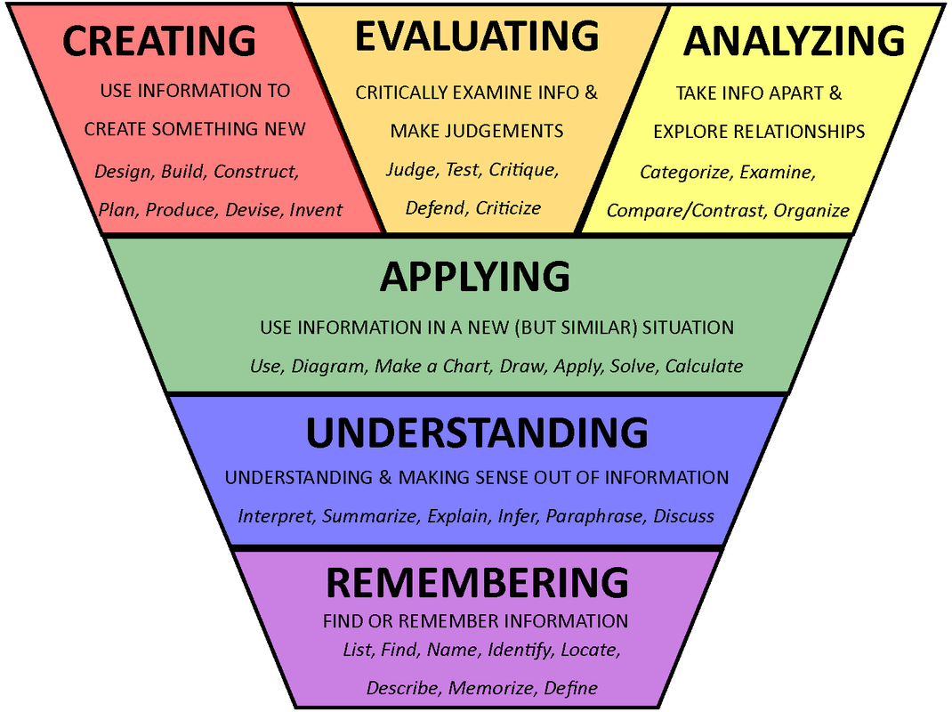
Progression of Thinking Skills
Sharon Bowman

Slide 68
Thinking and Talking Promote Students’ Understanding
Let’s hold students accountable
for their reading by listening to
what they have to say.

Slide 69
Oral Story-Telling in the Classroom
How do students benefit from oral story-telling?
Identify two benefits of story-telling in the following video?

Slide 70
Oral Storytelling

Slide 71
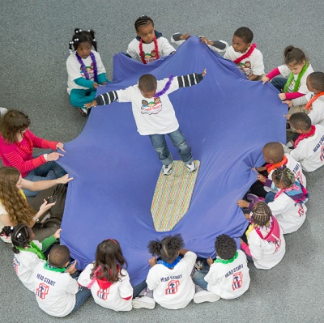
Share Back

Slide 73
Traditional Oral Story-Telling Purposes

Slide 74
The Relationship of the Story-telling and the Listener
“… Some say we should listen with three ears: two on our head and one in our heart.”
(Joanne Archibald, 1997 - Stol:o Nation Scholar).

Slide 75
Literacy 44
Literacy44.ca

Slide 77
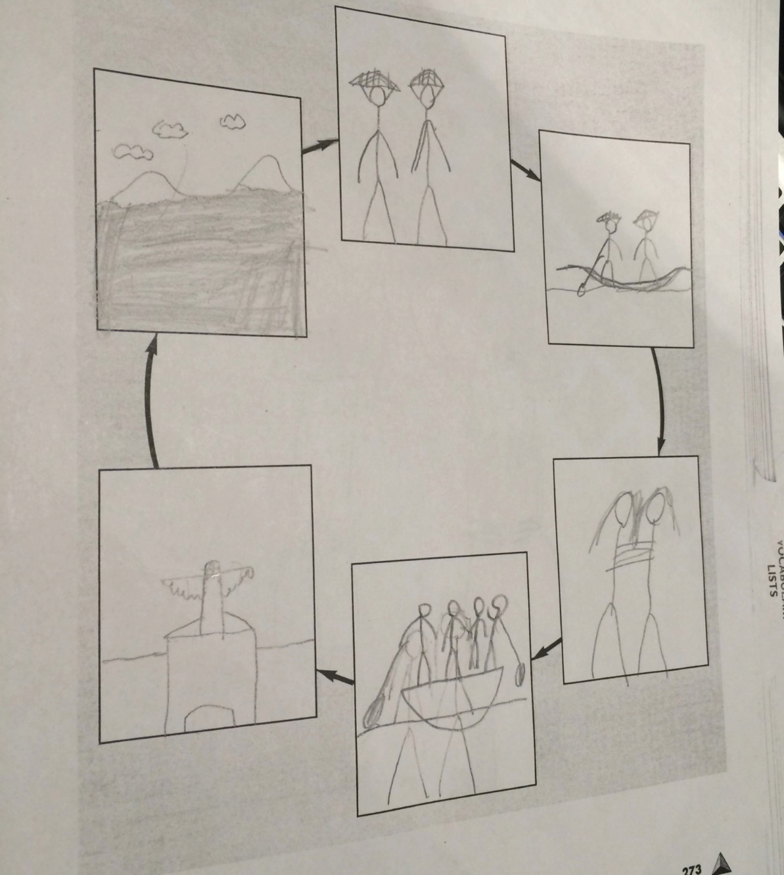
Student Sample

Slide 78
En Français...

Slide 79
All That We Are Is A Story
“All that we are is story. From the moment we are born to the time we continue on our spirit journey, we are involved in the creation of the story of our time here. It is what we arrive with. It is all we leave behind. We are not the things we accumulate. We are not the things we deem important. We are story. All of us. What comes to matter then is the creation of the best possible story we can while we’re here; you, me, us, together. When we can do that and we take the time to share those stories with each other, we get bigger inside, we see each other, we recognize our kinship – we change the world, one story at a time…”
―(Richard Wagamese Anishinaabe Author)

Slide 81
Literacy Resources
https://cr4yr.ca
http://literacy44.ca
Notes:
Jillian
https://cr4yrintermediate.wordpress.com
literacy44.ca
CR4YR has handouts and information about each session
Literacy44 has the resources from Reading 44 and Writing 44, some may have had presentations about literacy44 at schools
All handouts at today’s sessions are available online… handouts for other sections
Website links
Links to click from slide
Morning of… browser windows minimized and ready to pull up

Slide 82
School Action Plan
Discuss today’s session with your school team.
Use your organizer to record your plan for your school.
Please complete the email survey and
check out the resources table.
Thank you for coming!
Notes:
Jillian
Closing/Conclusion
Direct back to note taking template
Discuss at table what you think the most salient points are for you to take back to your schools
Inform of the survey that will be sent, please complete the survey
School Action Plan
Resource material
Email Survey
Door prize
https://cr4yrintermediate.wordpress.com

