Slide 1
Changing Results for Young Readers
The Intermediate Grades
North Vancouver School District
January, 2016

Slide 2
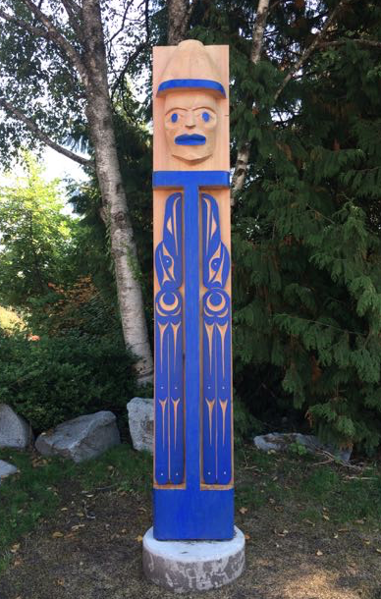
Traditional Welcome
We would like to start by acknowledging and thanking the Coast Salish people whose traditional territory North Vancouver School District resides on.
We express our gratitude to the
Squamish Nation and
the Tsleil-Waututh Nation.
We value the opportunity to learn, live and share educational experiences on this traditional territory.
Notes:
Kathleen

Slide 3
Reconnaissance du territoire traditionnel
J’aimerais reconnaître et remercier
les peuples autochtones de la côte Salish dont leur territoire traditionnel
est le siège de la Commission scolaire
de Vancouver Nord.
Nous exprimons notre gratitude envers
les Nations Squamish et Tsleil-Waututh.
Nous apprécions l’occasion d’apprendre, de vivre et de partager des expériences éducatives sur ce territoire traditionnel.
Notes:
Kathleen

Slide 4
The Leadership Team
Ann Copp
Cheryl Ham
Darlene Sulis
Heather Myhre
Jenny Crowe
Jessica Johnson
Jillian Gordon
Johneen Harris
Kammi Clark
Nadya Rickard
Nicky Paiuk
Stéphanie Weller
Notes:
Kathleen

Slide 5
CR4YR-I: the next three weeks
3 sessions 8:30am-11:30am
January 12, 20, 26, 2016
Carson FOS
Handsworth FOS
Seycove FOS
January 13, 19, 27, 2016
Argyle FOS
Sutherland FOS
Windsor FOS
School teams:
Intermediate teams:
1 grade 4 or 5 teacher
1 Teacher Librarian
1 grade 6 or 7 teacher
1 Administrator
1 LAC teacher
Notes:
Kathleen

Slide 6
History of CR4YR
Province-wide initiative launched by the Ministry of Education in 2012
Goal is to increase the number of children who are engaged, successful readers
Initiative uses current research on what fosters reading success
Notes:
Kathleen

Slide 7
CR4YR: NVSD Perspective
The North Vancouver School District has:
Participated in the CR4YR initiative for the past three years
Focused on:
Primary grades
Promoting teacher inquiry into literacy
Creating collaborative models of intervention for struggling readers
Notes:
Kathleen

Slide 8
CR4YR Project Goals - 2016
Provide strategies/ideas for intervention and support for struggling readers
Continue with an inclusive model of universal, targeted and intensive interventions for intermediate students who struggle with reading
Focus on establishing literacy learning communities in the school/FOS
Integrate the Literacy44 website into the CR4YR series
Notes:
Kathleen
Needs updating from the discussion Mon. Oct 26

Slide 9
Making a Difference
Notes:
Kathleen

Slide 10
CR4YR Learning Targets #1
Balanced Literacy Programs
To enhance literacy leaders’ and teachers’ capacity in literacy instruction
To understand the intermediate reader
To explore literacy resources and strategies for the intermediate classroom
Notes:
Jillian
Each session’s learning targets

Slide 11
CR4YR Learning Targets #2
Fluency and Oral Language
To enhance teacher capacity for teaching and assessing oral language and fluency
To understand the importance of fluency and oral language in the intermediate classroom
To explore strategies for teaching and assessing oral language and fluency
Notes:
Jillian
Each session’s learning targets

Slide 12
CR4YR Learning Targets #3
Comprehension
To enhance teachers’ repertoire of strategies to help struggling readers with comprehension
To understand how comprehension changes and develops in the intermediate grades
To explore aspects of comprehension
Notes:
Jillian
Each session’s learning targets

Slide 13
CR4YR Session 1 Agenda
Balanced Literacy Programs
Participants as Literacy Leaders
Balanced Literacy Models
Student Support
Engagement and Motivation
Student Centered Classrooms
Background Knowledge
Word Attack
Vocabulary Building
Notes:
Jillian
Today’s agenda

Slide 14
Participants as Literacy Leaders
Notes:
Jillian
You are literacy leaders in your schools…
Building on knowledge…
Going to look at our strengths/areas for growth
Consider ways to implement this CR4YR program in classrooms
Could schedule/Share info Intermediate team meetings
Committing to making the time to “spread the word”
4 mins

Slide 15
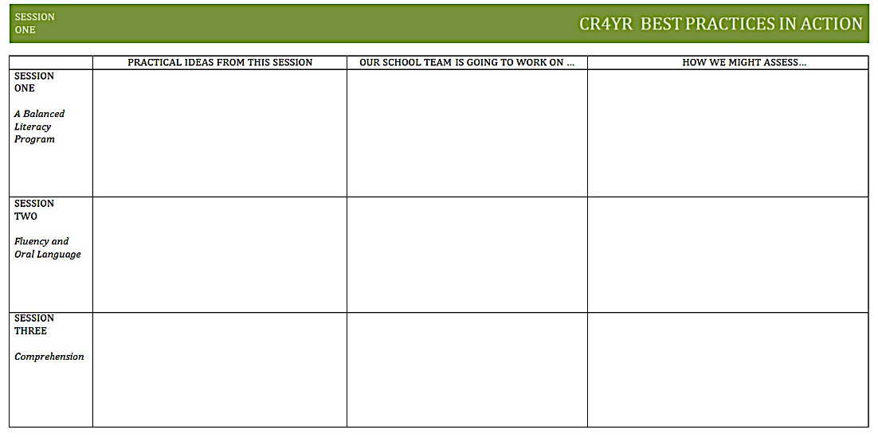
School Action Plan
Notes:
Jillian
Introduce graphic organizer to help guide
Encourage you to
Part of the practical ideas might be resources… CR4YR and Lit44 websites

Slide 16
Literacy Resources
http://cr4yr.ca/
http://literacy44.ca
Notes:
Jillian
https://cr4yrintermediate.wordpress.com
literacy44.ca
CR4YR has handouts and information about each session
Literacy44 has the resources from Reading 44 and Writing 44, some may have had presentations about literacy44 at schools
All handouts at today’s sessions are available online… handouts for other sections
Website links
Links to click from slide
Morning of… browser windows minimized and ready to pull up

Slide 17
Literacy Leaders
“Literacy leaders embody the “mindframes” that support and guide literacy instruction.”
(Hattie, 2002)
Notes:
Darlene

Slide 18
Literacy Leaders
“Teachers and school leaders who develop these ways of thinking are more likely to have major impacts on student learning.”
(Hattie, 2002)
Notes:
Darlene

Slide 19
Literacy Leader Mindframes
Use language of learning
Develop positive relationships
Enjoy the challenge
Evaluate the effectiveness of their teaching
Engage in dialogue
Talk more about the learning
Understand assessment as feedback
Are agents of change
Notes:
Darlene

Slide 20
Reading Myths
Learning to read, like learning to talk, is a natural process
With time, all children will eventually learn to read
Genetics rule: if the child has dyslexia, he or she cannot be helped
If you start at a disadvantage, you will never catch up
After Grade 3, children are done learning how to read
Children can learn to read by relying heavily on context cues
Students can master reading comprehension if they just read, read, and read
English has so many irregular spellings and inconsistencies that it is impossible to teach
(Canadian Language &Literacy Research Network, 2008)

Slide 21
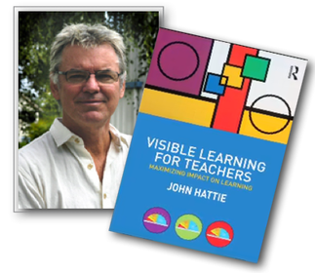
Research Says…
Dr. John Hattie
http://visible-learning.org
Notes:
Darlene

Slide 22
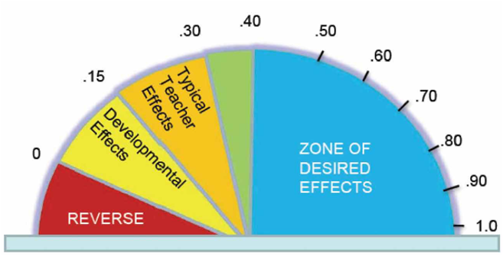
Influences and Effect Sizes Related to Student Achievement
1. (1.44) Helping students develop high expectations for themselves
3. (1.07) Response to Intervention
4. (0.90) Educators providing their colleagues with formative assessment feedback on their teaching practices
6. (0.88) Direct teaching of phonics to a small group of students who need it
10. (0.75) Providing feedback to a student on his/her reading fluency
11. (0.74) Reciprocal Teaching
12. (0.72) Teacher - Student relationships
Notes:
Darlene

Slide 23
14. (0.69) Teaching meta-cognitive skills (eg: think alouds during reading)
17. (0.67) Explicit teaching of vocabulary
23. (0.62) Professional Development / Growth
36. (0.54 - 0.6) Phonics instruction for the whole class
37. (0.54) Student Centered Classroom
46. (0.52) Interactive Video Methods
94. (0.29) Homework (e.g. spelling lists)
Notes:
Darlene

Slide 24
Mindsets
Dr. Carol Dweck
vs.
Notes:
Nicky

Slide 25
Attribution Theory of Motivation
 | Internal | External
Stable | ABILITY | TASK DIFFICULTY
Unstable | EFFORT | LUCK
Notes:
Learned helplessness comes when students attribute success to external factors and failure to lack of ability
Who and what you attribute your success or failure to makes a huge difference in how you behave.

Slide 26
Praise Can Be Harmful
“Good Job”
Praise undermines the intrinsic motivation of students
“Power of “Yet”
Infers that they are on a learning curve
Notes:
Kids come into the world infinitely curious

Slide 28
Growth Mindsets Making an Impact
Tulalip Tribes
K-5 students
90% minority
80% low income school
bottom 5% of the state
Notes:
Cultural framing for mindset intervention; strong emphasis on nations values
Teachers and parents instructed in everyday practices
After 1-1.5 Years
K and 1 lead district in oral reading fluency: 95% of kindergarten and 80% of 1st graders are proficient or above in reading
3rd grade literacy: On state literacy test, 68% of 3rd grade students met or were within 10 points of standard. Most had been more than 100 points below standard in the fall (on 600 point test)
3rd-5th grader literacy and math: 60% of all students are showing more than one year of growth; and at least half of these students are showing 1.5-2 years of growth (Measure of Academic Progress)

Slide 29
Teaching for Growth Mindset
“Fail Courageously”
– Dr. Martin Brokenleg
Lesson for Teachers and Students
“Whether you think you can, or you think you can’t – you’re right”
– Henry Ford

Slide 30
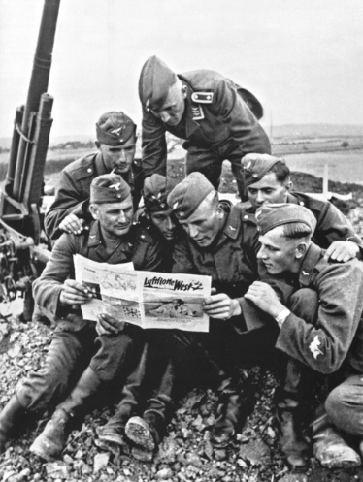
Balanced Literacy
First People’s Principles of Learning
Learning is holistic, reflexive, reflective, experiential, and relational (focused on connectedness, on reciprocal relationships, and a sense of place)…
…so is becoming literate
Notes:
Nicky

Slide 31
What is a balanced literacy program?
Is there one model?
What are the components of a balanced literacy program?
Notes:
Nicky

Slide 32
Balanced Literacy
“A balanced literacy plan is most effective
when children are given direct instructional support
and a variety of daily reading and writing experiences
that are needed in the complex process
of becoming independent readers and writers.”
(WRESA, 2015)
Notes:
Nicky

Slide 33
Balanced Literacy
A balanced literacy program supports B.C.’s
new curriculum design.
“At the heart of British Columbia’s redesigned curriculum are core competencies, essential learning and literacy and
numeracy foundations.”
(BC Ministry of Education, 2015)
Notes:
Nicky

Slide 34
Balanced Literacy
First People’s Principles of Learning
Learning is holistic, reflexive, reflective, experiential, and relational (focused on connectedness, on reciprocal relationships,
and a sense of place).
Notes:
Nicky

Slide 35
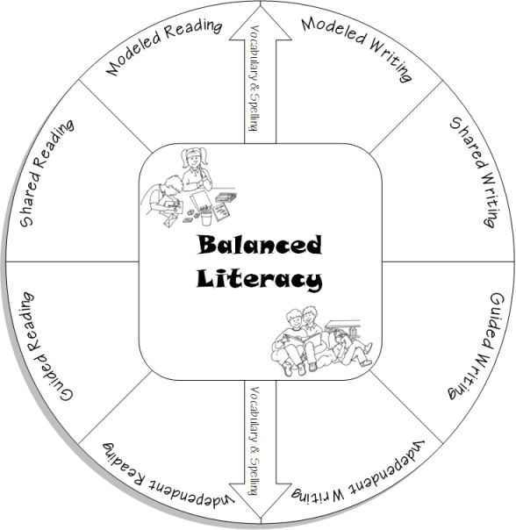
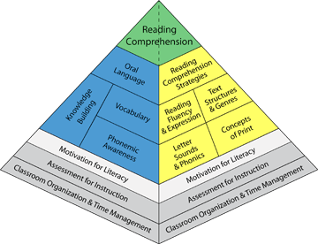
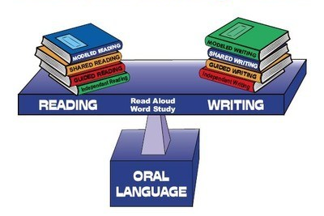
Balanced Literacy
As Literacy Leaders, think about…
“In what ways am I already helping my students to learn language, to learn about language, to learn through language, and to use language to critique?”
(Vasquez, 2003)
Notes:
Nicky

Slide 36
Balanced Literacy
Build a Balanced Literacy Model
Consider the following:
Core Literacy Components:
Reading
Writing
Speaking
Listening
Viewing
First Peoples Principles of Learning:
Holistic
Reflexive
Reflective
Experiential
Relational
When finished, complete this sentence:
A balanced literacy program ______________.
Notes:
Nicky

Slide 37
Balanced Literacy
Gallery Walk
Please feel free to respond to the
balanced literacy models.
Notes:
Nicky

Slide 38
Engagement and Motivation
Donalyn Miller
http://bookwhisperer.com
Notes:
Jenny

Slide 39
Engagement and Motivation
Reading must be an endeavor that:
Has personal value to students
Students see themselves as capable of doing
Is free from anxiety
Is modeled by someone they like, respect, trust, and want to emulate
(Miller, 2009)
Notes:
Jenny

Slide 40
Engagement and Motivation
Notes:
Jenny

Slide 41
Engagement and Motivation
Notes:
Jenny

Slide 42
Engagement and Motivation
Notes:
Jenny

Slide 43
Engagement and Motivation
Notes:
Jenny

Slide 44
Engagement and Motivation
Notes:
Jenny

Slide 45
Engagement and Motivation
Notes:
Jenny

Slide 46
Engagement and Motivation
Notes:
Jenny

Slide 47
Engagement and Motivation
Notes:
Jenny

Slide 48
Intermediate Aboriginal Literature
Notes:
Jenny

Slide 49
Intermediate FI and FSL Literature
Notes:
Jenny

Slide 50
Student Support
Words Have Meaning
What is the need?
What is the best fit?
What are our assumptions?
Notes:
Ann

Slide 51
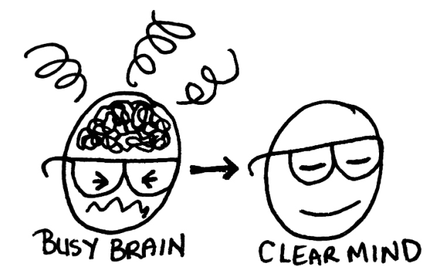
Student Support
There’s A Lot Going On
Attention / focus
Executive functioning
Working memory
Symbol retrieval
Processing speed
Reliance on writing for reading activities
Anxiety
Explicit Teaching of Strategies
Win - Win
(Hawthorne)
(Dawson & Guare)
(Reid)
Notes:
Ann

Slide 52
Student Centered Classroom
First People’s Principles of Learning
Learning involves recognizing
the consequences of one’s actions.
Notes:
Nicky
Learning involves recognizing the consequences of one’s actions

Slide 53
Student Centered Classroom
Learner Centered Literacy:
Owning their Own Reading
https://m.youtube.com/watch?v=xxx0P_euuSw
Notes:
Nicky
Learner centered literacy: owning their own reading.
https://m.youtube.com/watch?v=xxx0P_euuSw
start from .10-1.34 min then cut to 2.03-2.52 min.

Slide 54
Student Centered Classroom
Daily 5 in Action: Grade 5/6
https://m.youtube.com/watch?v=6G-HaXw2IQE
Notes:
Nicky
Daily 5 in Action- Grade 5/6
https://m.youtube.com/watch?v=6G-HaXw2IQE
.12-5.40 minutes

Slide 55
Student Centered Classroom
Notes:
Nicky
Resources available in French too!

Slide 56
Student Centered Classroom
First People’s Principles of Learning
Learning involves patience and time.
Notes:
Nicky

Slide 57
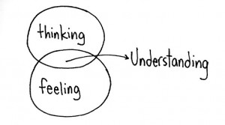
Comprehension
Meaning
Conscious control
Explicit teaching
(Harvey & Daniels, 2012)
Notes:
Ann

Slide 58
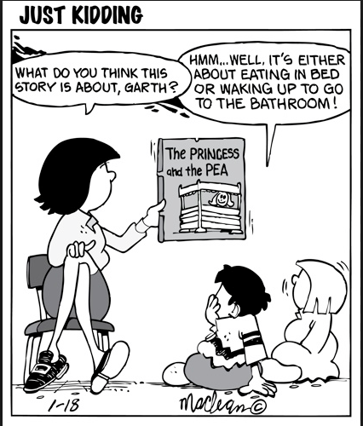
Background Knowledge
Engagement
Connection to text
Constructivism
Shared understanding
Concept attainment
(vocabulary)
Notes:
Ann
Refer to lit

Slide 59
Vocabulary Building
First People’s Principles of Learning
Learning is embedded in memory, history, and story.
Notes:
Nicky

Slide 60
Vocabulary Building
Vocabulary is necessary:
To communicate
Navigate the social environment
Read effectively
(Zaner-Bloser, 2015)
Notes:
Nicky
https://www.zaner-bloser.com/news/research-behind-importance-teaching-vocabulary

Slide 61
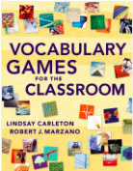
Vocabulary Building
Dr. Robert Marzano
http://www.marzanoresearch.com
Notes:
Nicky

Slide 62
Vocabulary Building
Notes:
Nicky

Slide 63
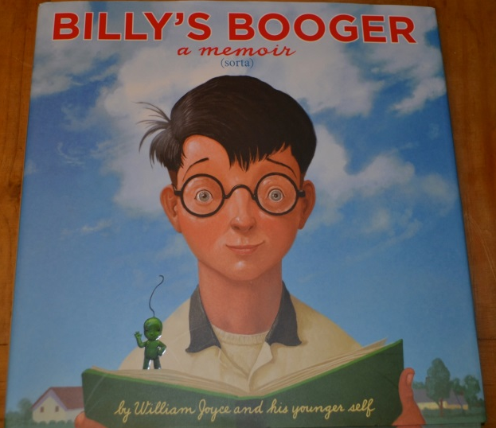
Vocabulary Building
Each table has 6 different tasks that
follow Marzano’s practice.
Each person is to try one of the tasks using
their choice of vocabulary from our story.
mayhem mucus
grindstone memoir
honourable glumly
imagination roamed
Notes:
Nicky

Slide 64
Intermediate Decoding
First People’s Principles of Learning
Learning is holistic, reflexive, reflective, experiential, and relational (focused on connectedness, on reciprocal relationships, and a sense of place).
Notes:
Jillian
Intermediate teachers can not assume that our students will all be able to decode words
Connect back to reading myth about learning to read being over in grade 3
One way to teach these skills in the intermediate context is through inquiry
Students making their own meaning… coming to understand
Inquiry good because multiple entry points…
We may have to teach kids
Breaking into syllables
Looking for smaller words in larger words
Looking for base words
Using context clues
Reading prefixes and suffixes
This year, noticed my class was struggling with prefixes and suffixes and many were having a hard time using them in their writing and oral reading… formative assessment
Talk about lesson…
Differentiation
Thinking about explicit skill building
Assessment
Making thinking visible…

Slide 65
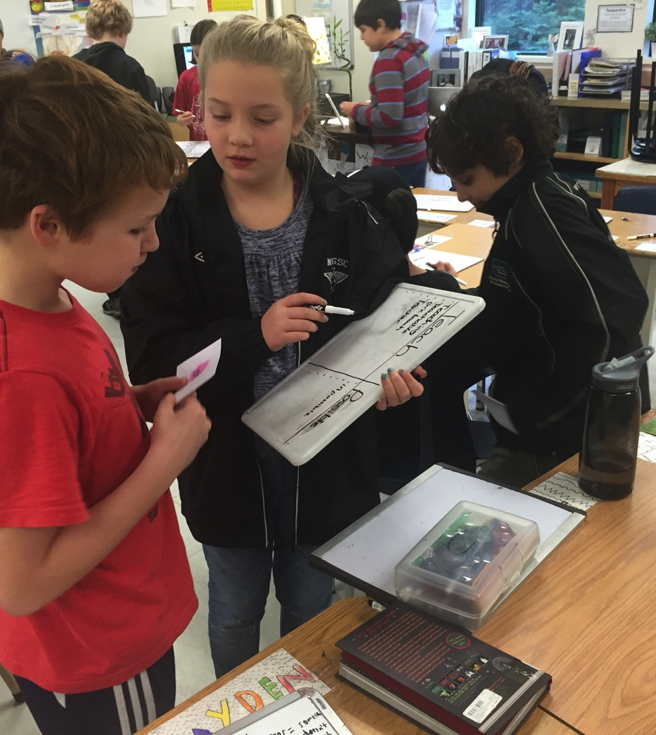
Intermediate Decoding
Notes:
Jillian

Slide 66
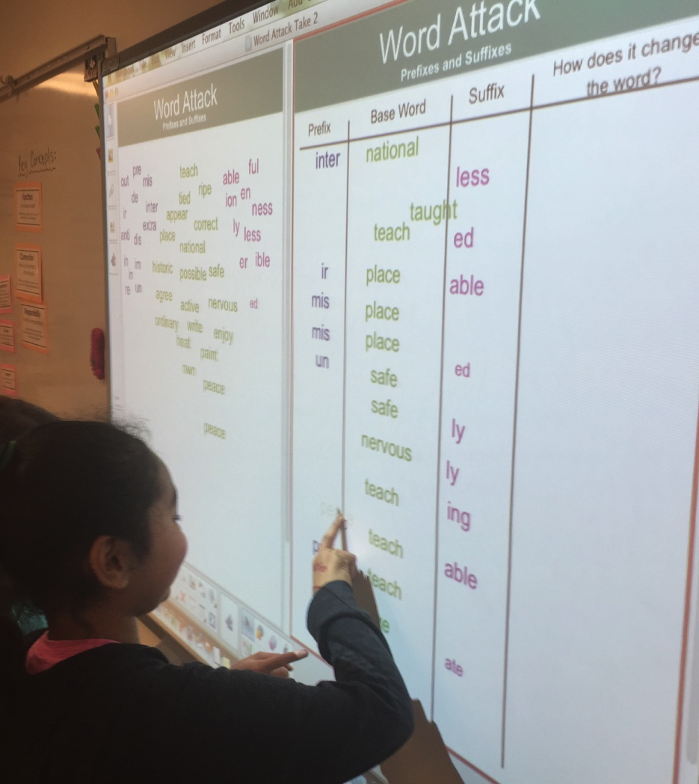
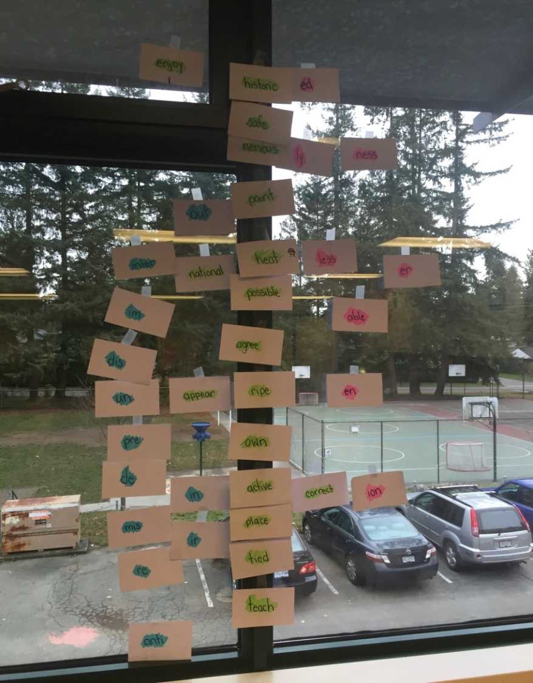
Intermediate Decoding
Notes:
Jillian
Also mention code chart on wall

Slide 67
Intermediate Decoding
Notes:
Jillian
Formative assessment
Differentiation

Slide 68
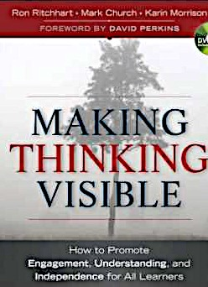
Intermediate Decoding
Making Thinking Visible
http://www.visiblethinkingpz.org
Notes:
Jillian
Link lesson to this resource

Slide 69
School Action Plan
Discuss today’s session with your school team.
Use your organizer to record your plan for your school.
Please complete the email survey and
check out the resources table.
Thank you for coming!
Notes:
Jillian
Closing/Conclusion
Direct back to note taking template
Discuss at table what you think the most salient points are for you to take back to your schools
Inform of the survey that will be sent, please complete the survey
School Action Plan
Resource material
Email Survey
Door prize
https://cr4yrintermediate.wordpress.com

Slide 70
Literacy Resources
https://cr4yr.ca
http://literacy44.ca
Notes:
Jillian
https://cr4yrintermediate.wordpress.com
literacy44.ca
CR4YR has handouts and information about each session
Literacy44 has the resources from Reading 44 and Writing 44, some may have had presentations about literacy44 at schools
All handouts at today’s sessions are available online… handouts for other sections
Website links
Links to click from slide
Morning of… browser windows minimized and ready to pull up

