Slide 1
Assessment

Slide 2
Assessment: the systematic process of gathering information about
student learning literacy44

Slide 3
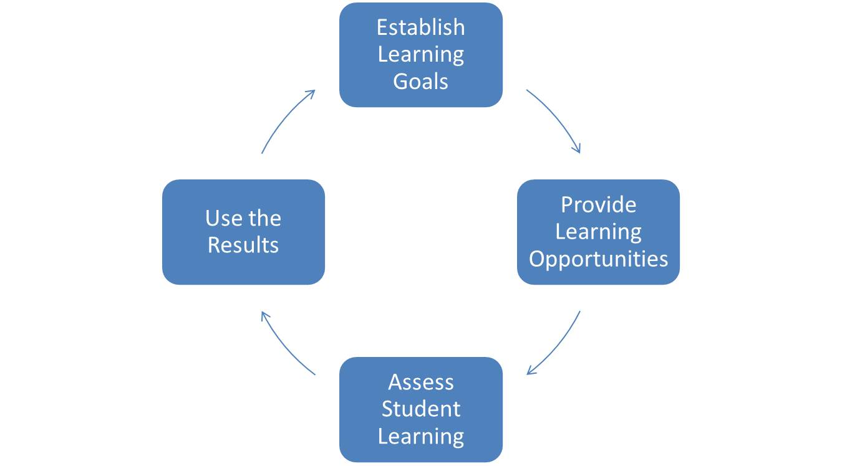
Assessment
BIG IDEA:
Assessment drives instruction

Slide 4
First Peoples Connections
Learning involves patience and time.
Learning is holistic, reflexive, reflective, experiential, and relational (focused on connectedness, on reciprocal relationships, and a sense of place).
Learning ultimately supports the well-being of the self, the family, the community, the land, the spirits, and the ancestors.

Slide 5
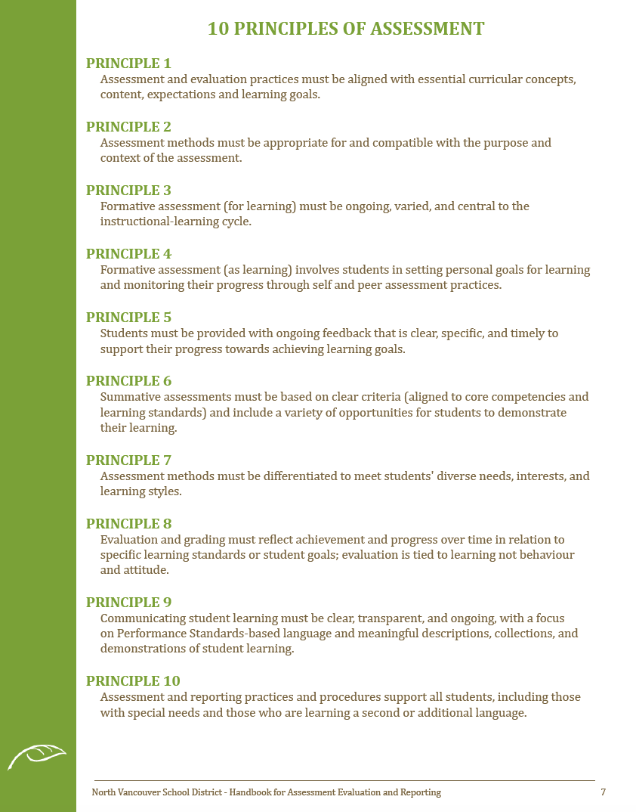
Assessment Handbook

Slide 6
Response To Intervention (RTI)
The practice of providing high-quality instruction and intervention matched to the students need, monitoring progress frequently to make decisions about changes in instruction and applying child response data to educational decisions
- National Association of State
Directions of Special Education

Slide 7
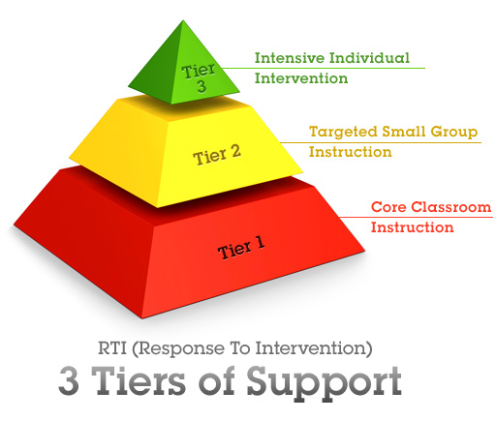
Response To Intervention (RTI)
Notes:
Kammi – typically, RTI is a method used for identifying students who need extra support, and is also used to identify a possible learning disability, rather than the discrepancy model
It can also be used as a way to determine who needs extra support in reading instruction, and who to get it from.
All students start at the bottom of the pyramid, and receive the same instruction and assessment as everyone else. From this, teachers use their observational skills and professional judgement to decide who may need more intensive support. This DOES NOT mean they jump straight to their LSTs to pull the kids out. Instead, now would be a good time to talk to the LST to get some ideas about what you could do to support these students, in class, but in a different, more targeted way. Another example of this is using your class based assessments to drive, or target your instruction. If after all of this, students are STILL struggling, that is when you would seek out the intense intervention at the top of the tier, and this could look many different ways.

Slide 8
SD44 Model
Level 1:
• Class-based intervention
• Teacher notices a challenges through observation or testing
• Teacher tries some interventions in the classroom (see adaptation checklist)

Slide 9
SD44 Model
Level 2:
• SBRT referral
• Teacher shares evidence of a challenge and details any class-based interventions with SBRT
• Team records challenges, makes recommendations, and may become involved.

Slide 10
SD44 Model
Level 3:
• ESBRT Level
• SBRT has tried a number of interventions (unsuccessful) which they share with the ESBRT
• ESBRT records challenges, makes recommendations, and may become involved.

Slide 11
Progress Monitoring
This is key
Need an initial assessment to establish a baseline and where to go
Use the baseline to set a goal
re-assess to see if progress is being made; track this progress and adjust goals if needed

Slide 12
Tier One Assessments
UNIVERSAL – In the Classroom
Teacher Observations
Student – Teacher Conferences
Classroom Reading Assessments
Running Records – one-on-one reading with students
RAD (comprehension)/ RELI
DRA (Diagnostic Reading Assessment)
PM Benchmark/ GB +
TOPA
Student self assessments

Slide 13
Tier Two Assessments
TARGETED – SBRT level
CTBS (Criterion Test of Basic Skills)
DIBELS
Running Record
DRA (Diagnostic Reading Assessment
Jerry Johns

Slide 14
Tier Three Assessments
INTENSIVE – ESBRT level
CTBS (Criterion Test of Basic Skills)
Running Record
Level B (e.g. WJ-III, KTEA2)
SLP
Psych Ed

Slide 15
Student Self Assessment
What students say about reading is extremely important
See literacy44.ca for frames to use
Have conversations with your students about reading

Slide 16
Observation
Students who avoid reading
Strong decoding, weak comprehension
PM benchmark Summary of Reading Behaviours
Your observations are valid!
Notes:
Ilona - refer to quick scales, performance standards

Slide 17
Running Records
Why use a Running Record?

Slide 18
Symbols and Conventions

Slide 19
Running Record Demonstration
How does the teacher introduce the assessment?
What kind of positive feedback does she give the student?
What support or instruction will he need next?
https://www.youtube.com/watch?v=ZO-4OYiJiUA

Slide 20
Process
Time to practice:
Using the recording symbols – listen + code the running record.
Notes:
Old cell phones are perfect for this!

Slide 21
Process
Use technology!
OneNote
One student per day
Notes:
Old cell phones are perfect for this!

Slide 22
Now What?
“Successful learning
for all students cannot be addressed by groups of professionals working in isolation. It
requires genuine collaboration at every level of the organization. This requires mutually
respectful learning among all those involved.”
(Inclusive Education Handbook, p. 4)

Slide 23
My Assessment is Done, Now What?
Once you have finished your reading assessments, what do you do with the information you collected?
Think: What do you know about this topic?
Puzzle: What questions do you have?
Explore: How can you explore the topic?

Slide 24
Now What?
Reading Level:
Frustration (> 90% word recognition, many repetitions, not fluent)
Instructional (95% word recognition, few repetitions, fluent)
Independent(99 %+ word recognition, few or no repetitions, very fluent)

Slide 25
Now What?

Slide 26
Now What?
Fluency:
Reading Rate (too fast, too slow or just right?)
Prosody (expression or no expression)
Accuracy (mistakes? Do they notice?)

Slide 27
Now What?

Slide 28
Now What?
Comprehension:
Re-tell - Summarize
Topic – Main idea
Fact – Key details
Evaluation–Opinion
Inference
Vocabulary

Slide 29
Now What?

Slide 30
School sharing
NOW
How do you plan to take this information back to your school to help shape your school’s reading assessment program?

Slide 31
Literacy Resources
http://cr4yr.ca/
http://literacy44.ca
Notes:
In each presentation prior to jigsaw

Slide 32
Putting The Pieces Together
Jigsaw Part 2 = School groups
Notes:
NICKY

Slide 33
Agenda
10:00am- 1:00pm
Coffee Break | Skyview
Puzzle Jigsaw Experts share 3,2,1 sheet | Mountainview
School Team session Develop plan to take back to school How is your team going to present this information to your school What are your school’s needs? How will you move your school forward with the literacy agenda? | Mountainview
Lunch
Notes:
After the jigsaw slide

