Slide 1
Critical Literacy
Nicky, pat, darlene, jillian

Slide 2
Big Idea
Critical literacy is a skill necessary to navigate our social world.

Slide 3
Learning Targets
To understand the meaning and the role of critical literacy
To explore strategies for the primary and intermediate classrooms
To examine the connection between critical literacy and multi-literacies

Slide 4
Why Critical Literacy?
Dr. Allen Luke
https://www.youtube.com/watch?v=UnWdARykdcw

Slide 5
Learning Task: OWI

Slide 6
Posing Questions Strategy
Questions to ask when exploring text through the lens of critical literacy:
Is the author trying to send a deeper message?
Who is the message intended for?
Who would agree or disagree with the message?
Are other viewpoints missing?
What techniques has the author used to influence the reader?
How might the text differ if it had been written by someone else?
Who is marginalized in this text? Who is empowered?

Slide 7
Critical Literacy for Social Justice
"Critical literacy is the ability to read texts in an active, reflective manner in order to better understand power, inequality, and injustice in human relationships."
Coffey, 2008
Notes:
http://www.learnnc.org/lp/pages/4437

Slide 8
Empowering Students
Marley Dias, age 11
#1000blackgirlbooks

Slide 9
Connections to Indigenization
Learning is holistic, reflexive, reflective, experiential, and relational (focused on connectedness, on reciprocal relationships,
and a sense of place).
Learning requires exploration of one’s identity.

Slide 10
Connections to New Curriculum

Slide 11
Primary
"When my students are engaged from a critical perspective, they comprehend beyond, under, over and around their previous level of understanding."
Beth Gress, Grade 3 teacher

Slide 12
Critical Literacy Practices
"Teachers can use critical literacy practices to help create citizens and thinkers who are comfortable enacting change."
Norris, Lucas, & Prudhoe, 2012

Slide 13
Critical Literacy Framework
Engaging students' thinking
Guiding students' thinking
Extending students' thinking
Reflection

Slide 14
Critical Literacy Strategies
Problem Posing
Who is in the text/picture/situation?
Who is missing?
Connection Stems
That reminds me...
I remember when...
If I were that character...
Patterned Readings
read-pause-predict
read-pause-discuss
read-pause-make connections
read-pause-sketch
read-pause-bookmark
read-pause-retell or summarize

Slide 15
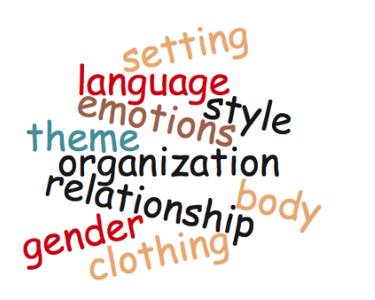
Switching Strategy
Changing an element of the text to identify how that change impacts the work

Slide 16
Critical Literacy Continuum
Posing questions strategy
Safe classroom community
Modelling
Teacher reflection
Opportunities to reflect and respond
Notes:
Connection between intermediate and primary
Logo as reference to links for website
Examples of Posing questions strategy:
Who wrote this story? How is that person connected to the story or the characters? What perspectives are included? What perspectives are omitted? What values does the text represent? How does the portrayal of the character represent those values? How does your background influence your understanding of the character? What are your connections with the character? How do you think the character would react to this situation? How would you feel if you were in that situation? Is the portrayal of the character positive or negative? How do you know? How do other characters view the character? Have you heard a similar story before? How is it the same and different? What is daily life like for the character? What is the setting and what is going on in it?

Slide 17
Juxtaposing Strategy
Comparing two or more texts on the same topic in order to identify similarities and differences in the portrayal of events and characters
Tug-of-war
Circle of viewpoints
Red light, yellow light
http://www.visiblethinkingpz.org

Slide 18
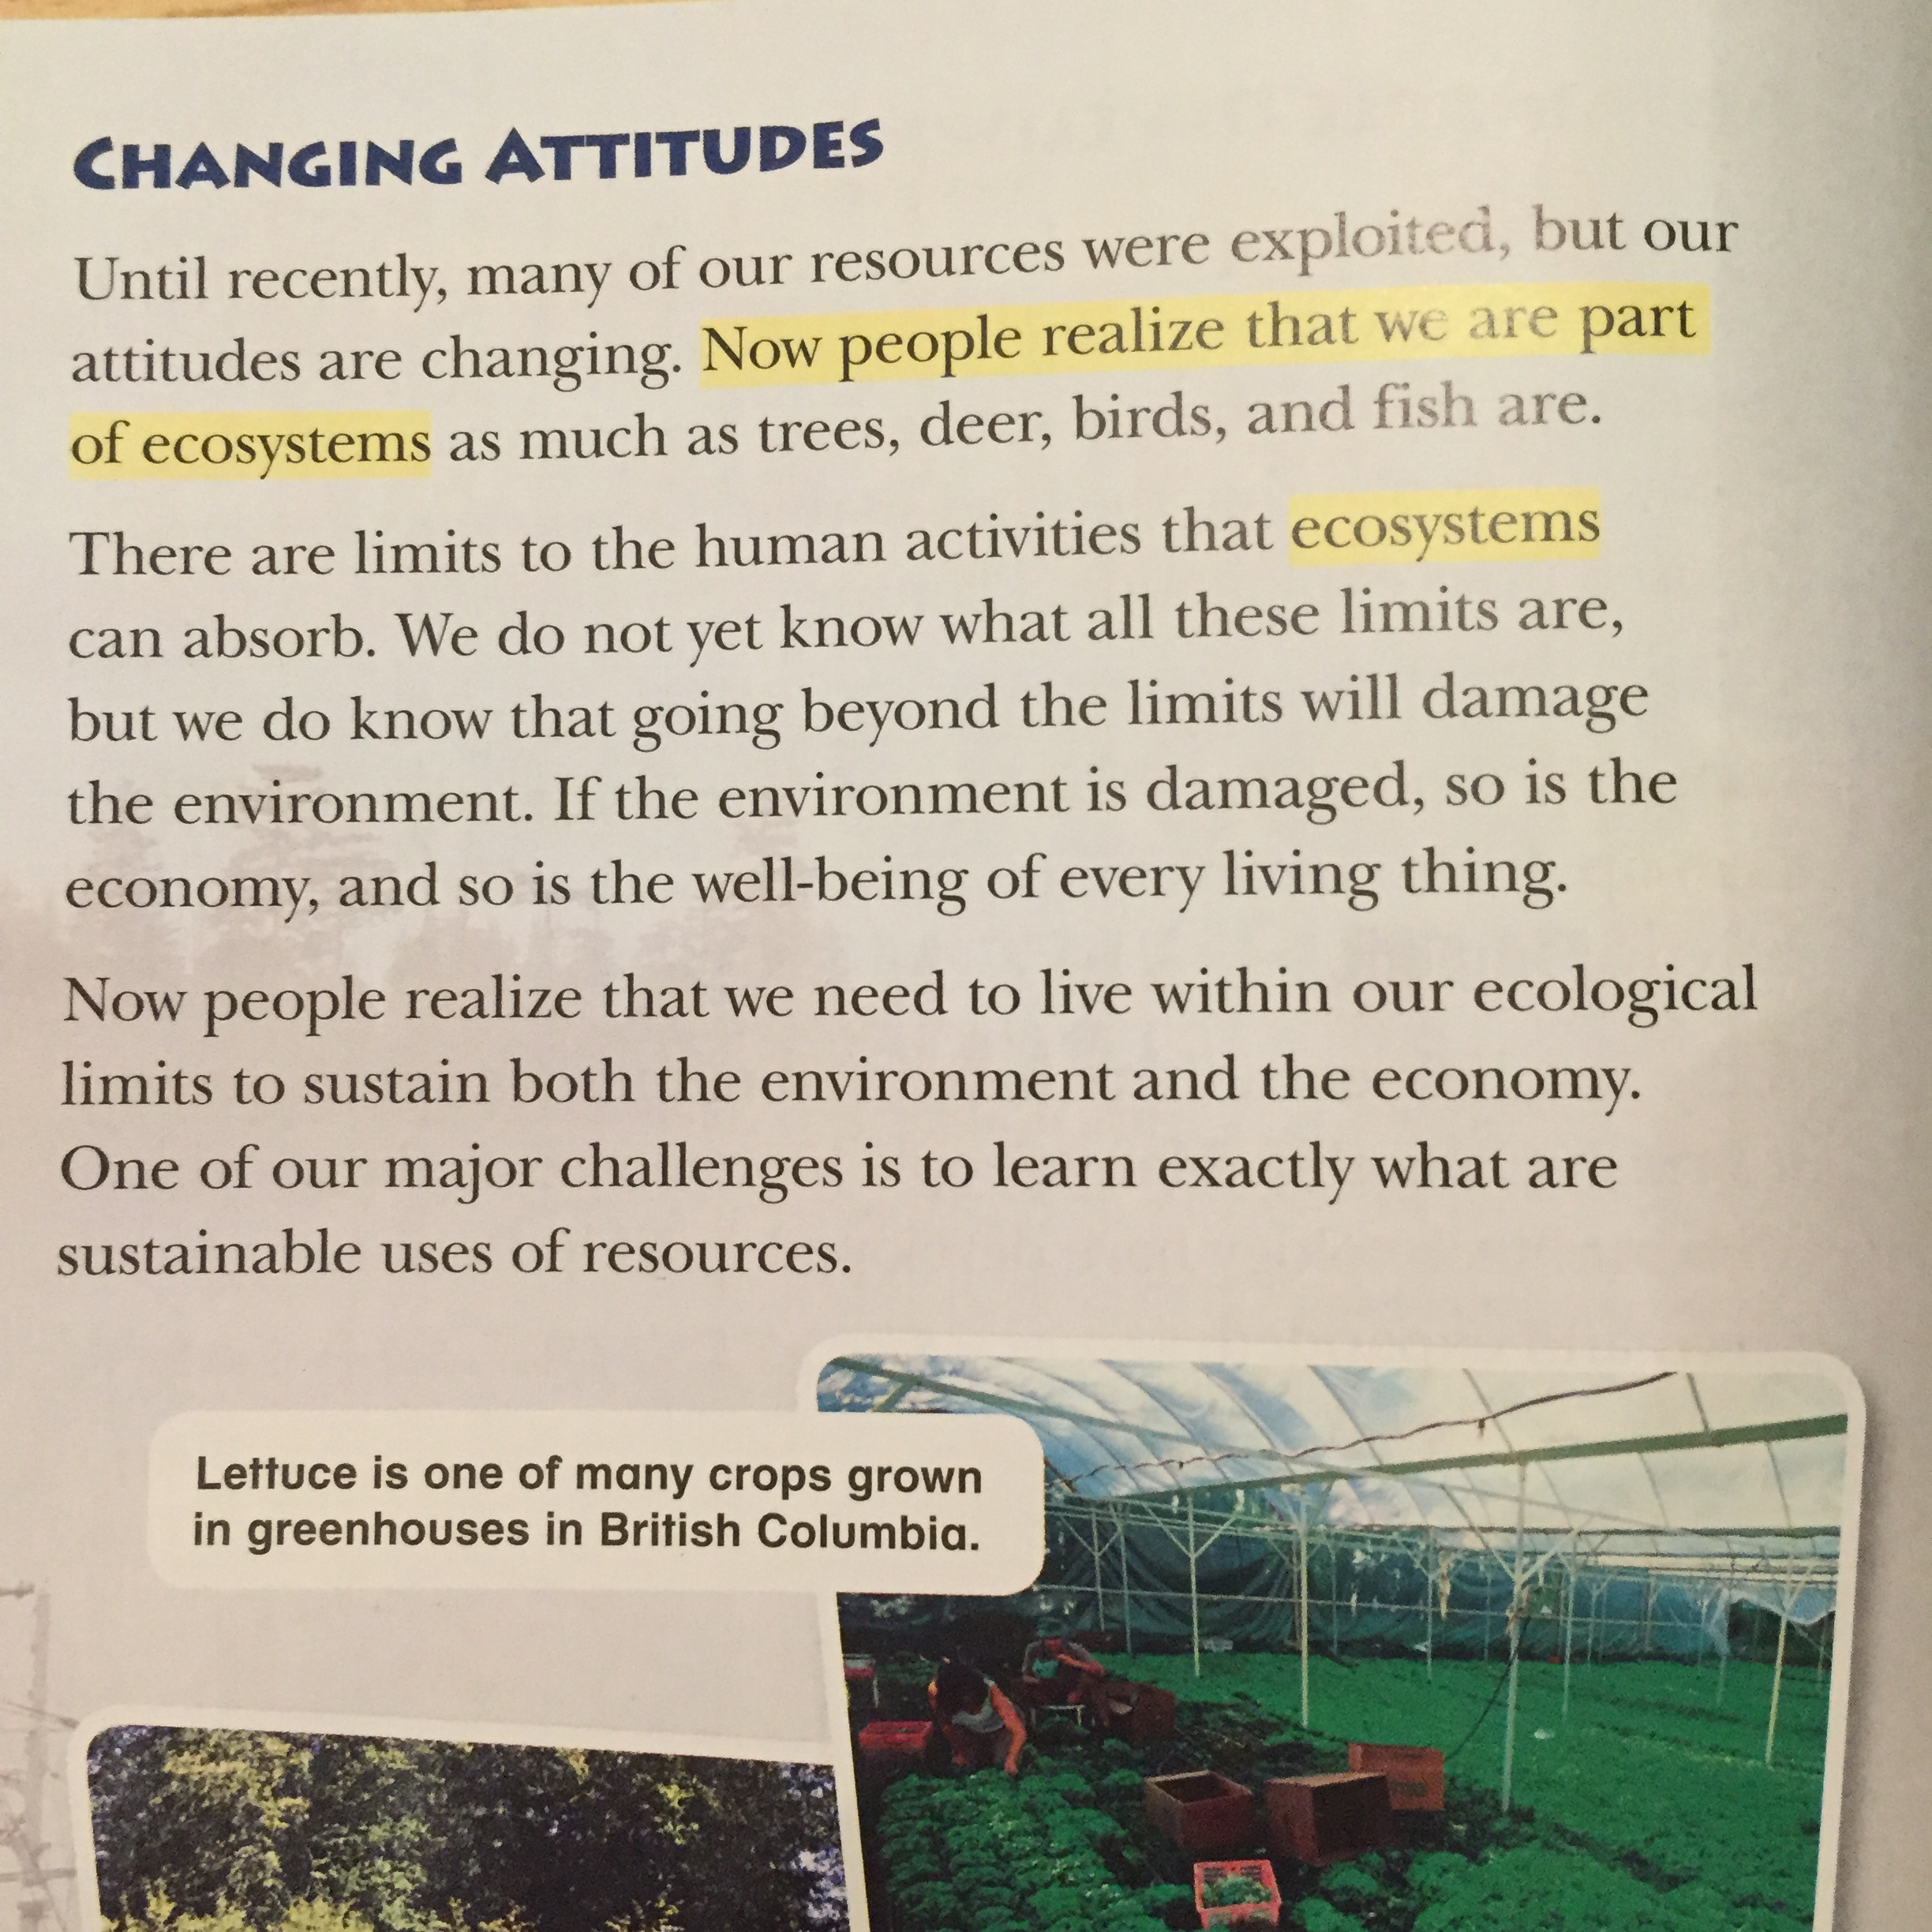
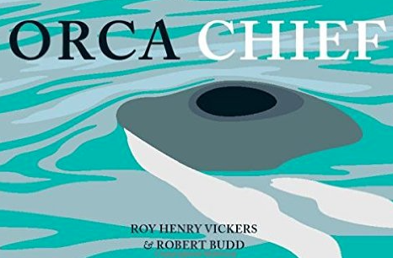
Juxtaposing- Traditional Knowledge

Slide 19
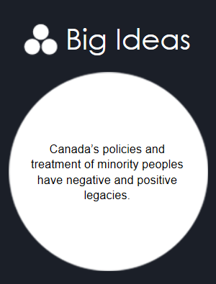
Juxtaposing- Perspective
Notes:
critically literate as teachers

Slide 20
Learning Task: Juxtaposing

Slide 21
Multi-Literacies
Financial literacy
Ecoliteracy
Health/fitness literacies
Cyber literacy
Media literacy
Social/emotional literacies
Multicultural literacy
Political literacy
Notes:
Critical literacy is very much connected to multi-literacies which you may also know as 21st century literacies.
Multiple literacies was coined by the New London Group in 1996 and refers emerging forms of literacy in today’s globalized, networked world.
I feel like a living example of having a glaring gap in my literacy skills. I can walk into a yoga class and flow through the poses at ease because I’ve got the literacy skills to do so. Sun salutation, no problem! Ujjayi breath.. You got it! I love to activate my first and second chakras. Whereas when I walk into an appointment at the bank, I begin to get a red splotchy rash on my chest the moment my financial advisor says words like ‘amortization’ and ‘bankruptcy’ because I’m scared she’s going to figure out that I have no clue what she’s talking about. Health literacy..high! Financial literacy..low!
Traditionally print text has been privileged in language arts classrooms but the notion of texts has broadened to include texts of all kinds, including images and sounds.
increasingly we encounter knowledge in multiple forms- in print, in images, in video. The challenge is to assist our student to achieve a more diverse folio of literacies.
We need to extend the range of literacy pedagogy so that it does not privilege alphabetical representations.
My kindergarten students will be in the heart of their careers in the year 2050 and we have no idea what that world is going to look like so it’s increasingly important to support our learners to be able to figure out differences in patterns of meaning from one context to another.
Filling out forms, reading blogs, signing a contract at a gym… these all requires different literacy skills. The key is being mindful of these various literacy forms so that we’re not unconsciously valuing one over the other. Our students will follow a number of different paths once they graduate.. The question is what literacy skills do they need to be successful?

Slide 22
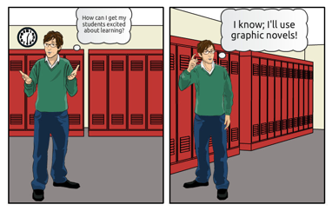
Graphic Novels…
“By their nature [graphic novels] force readers to get information from the art within a panel, from the progression of images from panel to panel, from the printed text of speech balloons and captions, and often from the in-art ‘audio’ text of sound effects—all at the same time. You must synthesize as you go”.
- Peter Gutierrez
Notes:
An example which highlights this is the popular graphic novel. Recently graphic novels have become a popular alternative for struggling readers, however graphic novels actually require different and possibly even more complex reading skills than traditional print texts. The inclusion of pictures, for example, does provide the reader with visual clues to help understand what is happening in the text; however, readers of graphic novels need to understand not only print text and visual images (facial expression and gestures, for example), but also how certain media techniques are employed for different effects. For example, why is a close-up used in a floating panel or how is a panoramic image used to convey a certain effect? Although comics have been around for decades, the increasing availability of graphic novels provide readers with opportunities to engage with a medium that complements the literacies required by the kinds of multimodal platforms many of them are immersed in daily, such as MSN, Facebook, Twitter and YouTube.
http://faculty.uoit.ca/hughes/Contexts/MultipleLiteracies.html

Slide 23
Deeper Understanding
Looking back at your OWI, how has your opinion been reinforced or changed?
https://www.youtube.com/watch?v=gdxXBqdfWME

Slide 24
Developing Informed Opinions

Slide 25
Another Opinion: Huffington Post
"The reality is that there are so few positive, powerful representations of black women and especially black girls out there that, frankly, it’s unsurprising that the photo would touch a nerve. That nerve, really, is where we should focus. That sensitivity, no matter how “over the top” it may seem to those who don’t get it, is still valid. It comes from a real place. It comes from a place that so many of the (mostly white) decision makers in the world of media are oblivious to. Perhaps if there were more black people and other people of color in positions of power in media and advertising, controversies like this one could be avoided."
Zeba Blay-Huffington Post
April 4, 2016

Slide 26
Now what?
"Teaching critical literacy is no longer an ‘option’ or something to be ‘added on’ to a literacy program. It is essential for students to become critical thinkers and producers of new knowledge if they are to see themselves as stakeholders in the future.”
(Booth, 2008)

Slide 27
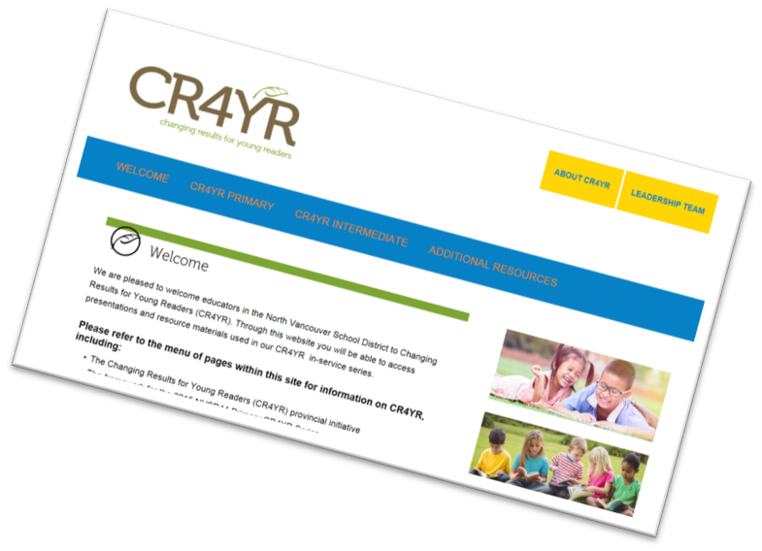
Literacy Resources
http://cr4yr.ca/
http://literacy44.ca
Notes:
In each presentation prior to jigsaw

