Slide 1
Developmental Stages of Reading
Jillian & Ilona

Slide 2
Big Idea
Intentional and informed literacy instruction by teachers at every grade level allows all children to learn to read.
Notes:
Jillian

Slide 3
Learning Targets
Deepen understanding of developmental stages of reading
Understand observation as powerful informal assessment and a precursor to further planning
Explore observable reading behaviors and systems for observation
Notes:
Jillian

Slide 4
Reading is a construct
“Human beings were never born to read.”
(Wolf, 2007)
Notes:
Ilona

Slide 5
Learning Task: Place the Stages
Work with a neighbor to place the pieces of the developmental readings skills pyramid.
Notes:
Ilona
Work with a neighbor to examine and place Participants examine stages and try to order them​
Coloured strips with broad categories​
Phonological awareness, code knowledge, etc (as sub categories, other colour) ​
Then throw in 6 decoding... place decoding anywhere along continuum... will generate conversation and get participants thinking about exceptions ​
Several bits of comprehension so they can slip it in multiple locations

Slide 6
Developmental Stages
Notes:
Ilona

Slide 7
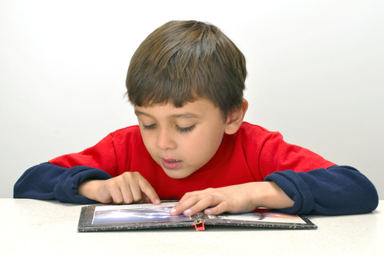
Developmental Stages
Joy …. Learning Adventures... New Ideas Critical Thinking
Comprehension
Fluency
Vocabulary
Phonics
Print Concepts
Phonemic Awareness
Language Rich Environment
Conversation
Stories
Notes:
Ilona

Slide 8
New Curriculum
Look at the reading specific content in the new curriculum.
What do you notice?
What are the implications for instruction?
Notes:
Jillian

Slide 9
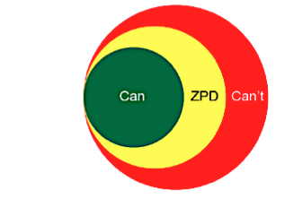
All Teachers Teach Reading
"When every teacher is a teacher of reading and every child works with text at his or her instructional level, then reading success will be within the grasp of all students."
(Reading 44)
Notes:
Jillian

Slide 10
First Peoples Principles
Learning involves patience and time.
Learning is holistic, reflexive, reflective, experiential, and relational (focused on connectedness, on reciprocal relationships, and a sense of place).
Notes:
Jillian

Slide 11
Power of observations
Notes:
Ilona

Slide 12
What To Look For - Whole Class
Questions to guide your observation:
What book have they chosen?
Are they returning to the same book or choosing something new each day?
Is the book the right way up?
What's going on under the table?
Are they out of the room multiple times?
What's going on with body language?
Notes:
Jillian

Slide 13
Reflect on your experiences
What less readily observable behaviors have your encountered?
What else should we look for?
Notes:
Jillian

Slide 14
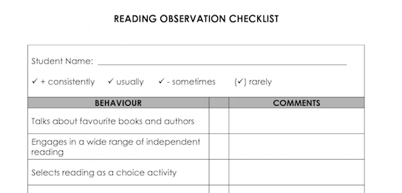
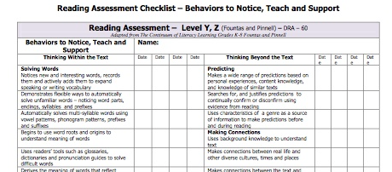
What To Look For - Individual
Notes:
Ilona

Slide 15
Systems for observations
Notes:
Jillian

Slide 16
Now what?
What do you do with all those observations?
Look for patterns
Ask further questions
Reflect on connections between observations and class environment
Tap into the power of collaboration
SBRT
Notes:
Ilona

Slide 17
Big Idea
Intentional and informed literacy instruction by teachers at every grade level allows all children to learn to read.
Notes:
Jillian

Slide 18
Learning Targets
Deepen understanding of developmental stages of reading
Understand observation as powerful informal assessment and a precursor to further planning
Explore observable reading behaviors and systems for observation
Notes:
Jillian

Slide 19
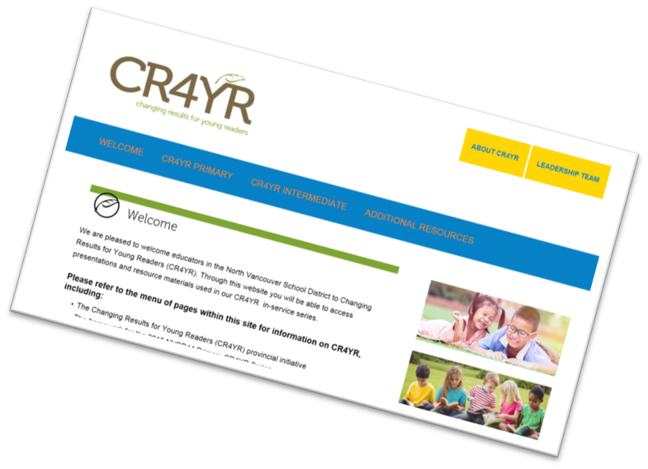
Literacy Resources
http://cr4yr.ca/
http://literacy44.ca
Notes:
In each presentation prior to jigsaw

Slide 20
Putting The Pieces Together
Jigsaw Part 2 = School groups
Notes:
NICKY

Slide 21
Agenda
10:00am- 1:00pm
Coffee Break | Skyview
Puzzle Jigsaw Experts share 3,2,1 sheet | Mountainview
School Team session Develop plan to take back to school How is your team going to present this information to your school What are your school’s needs? How will you move your school forward with the literacy agenda? | Mountainview
Lunch
Notes:
After the jigsaw slide

