Slide 1
Comprehension - K-7
Kammi, Pat, Nicky

Slide 2
Big Idea:
Comprehension is a continuum that depends on thinking and understanding; it needs to be explicitly taught and routinely practiced.
Notes:
Kammi

Slide 3
Learning Targets:
To explore the definition of comprehension
To determine when students are struggling with comprehension
To learn how to explicitly teach comprehension
Notes:
Kammi

Slide 4
What Is Comprehension?
Explore the definition of comprehension!
Consider the
First People's Principles of Learning:
Learning is holistic, reflexive, reflective, experiential, and relational (focused on connectedness, on reciprocal relationships, and a sense of place.
Notes:
Kammi can do this part of the presentation
Is there an order to which you teach the 4 strategies?
Do these not just with text

Slide 5
Comprehension Continuum
Notes:
Kammi

Slide 6
4 Strategies
Summarizing
Making Meaningful Connections
Self Regulating
Inferring
Lanning, 2009
Notes:
Kammi
Make sure to talk about how these can be used at both primary and intermediate levels!!
Also mention the interdisciplinary connections among curriculum – these four strategies should be taught/reinforced in other subject areas too – science, socials etc....even math!!

Slide 7
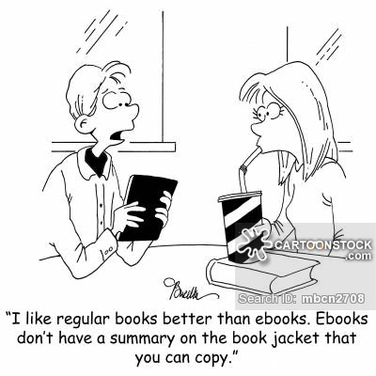
Summarizing
“Summarizing requires the reader to identify, paraphrase, and integrate important text information. Summarizing may occur across different lengths of text. It is a strategy in which a reader is constantly synthesizing the important ideas in text. “
Lanning, 2009
Notes:
Kammi
This is where we can get trapped at the far right of the continuum – asking for simple recall, versus remembering to paraphrase and integrate information. The key here is remembering to synthesize the important information
Speak to reading/writing connection

Slide 8
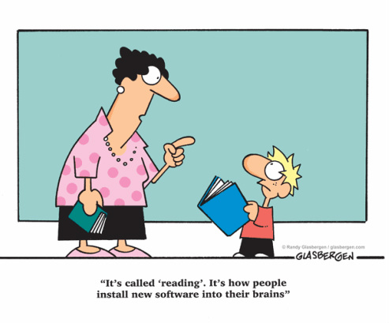
Making Meaningful Connections
“Connections…are made by bringing ones’ background knowledge to the information in the text. When creating meaningful connections, a reader is relating his or her previous experiences, knowledge, and/or emotions to the ideas presented in the text.”
Lanning, 2009
Notes:
Kammi -
Make sure to speak about the different kinds of connections – text to text, text to self, text to world and how you may need to create the situations for the students; especially those lacking in background knowledge
Tell story about using the Alexander stories with intermediates to build text to text connections

Slide 9
Self Regulating
“When self regulating, a reader is continuously checking his or her reading to make sure it makes sense, and is also using a variety of “fix up skills when it does not make sense. This process is more complex for struggling intermediate readers, because as texts become longer in length, the content less familiar, the vocabulary load higher and as authors employ more literary techniques in their writing. “
Lanning, 2009
Notes:
Kammi -
This is not behaviour, this is what we normally call self-monitoring

Slide 10
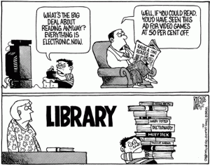
Inferring
"Inferring not only facilitates comprehension, but it also enhances the reader’s enjoyment of the text as new perspectives are discovered."
Lanning, 2009
Notes:
Kammi

Slide 11
Now What Do I Do?
We have resources and ideas for you!
Notes:
Kammi
Refer back to the cr4yr website plus handouts on table
Pat and Nicky to discuss more strategies to use

Slide 12
The Essence Of Reading
"...remember that comprehension is the essence of reading and that it has to be taught and cannot be left to chance!"
Rasinski et al, 2000
Consider the First Peoples Principles of Learning:
Learning involves patience and time.
Notes:
Pat- Without comprehension, reading is simply following words on a page...

Slide 13
How do we determine when students are struggling with comprehension?
listen carefully to our students' words
ask them questions
watch them closely
develop understanding of how they are doing and what they have learned – or not learned!
Notes:
Pat- we ask students questions and listen to the answers! We confer with kids, we observe behaviours and expressions, we read student responses closely.

Slide 14
Habits of Mind
"Good readers ask questions before they
read, as they read, and when they have
finished reading."
David Booth, 2008
Notes:
Pat - We ask students questions to determine comprehension, in turn we

Slide 15
Questioning
Notes:
Pat

Slide 16
Notes:
Pat

Slide 17
Think Aloud Strategy
peel back the layers of our thinking
make the invisible, visible
the importance of modelling
Notes:
PAT
Connect back to the beginning ; imbedding all four strategies into this
Model this with a read aloud

Slide 18
Inferring
"Merging of background knowledge with clues in the text to come up with an idea that is not explicitly stated by the author."
-Harvey and Goudvis
Consider the First Peoples Principle of Learning:
Learning requires exploration of one’s identity.
Notes:
Nicky
CONNECT BACK TO THE BEGINNING

Slide 19
Inferring
"What I like in a good author is not what he says, but what he whispers."
-Logan Pearson Smith
Notes:
Nicky

Slide 20
Summarizing
Notes:
Nicky
CONNECT BACK TO THE BEGINNING
Make sure to talk about the reading/writing connection – how summarizing can often become a written activity, as well as an oral one

Slide 21
Literacy Resources
http://cr4yr.ca/
http://literacy44.ca
Notes:
In each presentation prior to jigsaw

Slide 22
Putting The Pieces Together
Jigsaw Part 2 = School groups
Notes:
NICKY

Slide 23
Agenda
10:00am- 1:00pm
Coffee Break | Skyview
Puzzle Jigsaw Experts share 3,2,1 sheet | Mountainview
School Team session Develop plan to take back to school How is your team going to present this information to your school What are your school’s needs? How will you move your school forward with the literacy agenda? | Mountainview
Lunch
Notes:
After the jigsaw slide

