Slide 1
Changing Results for Young Readers: K-7
Literacy for all: supporting struggling readers

Slide 2
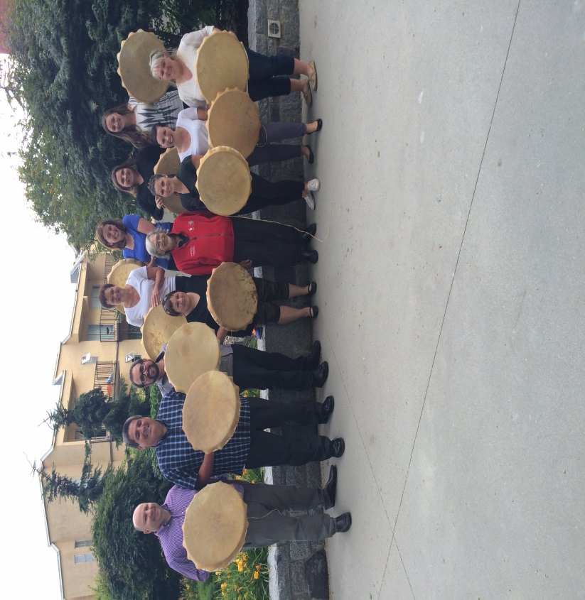
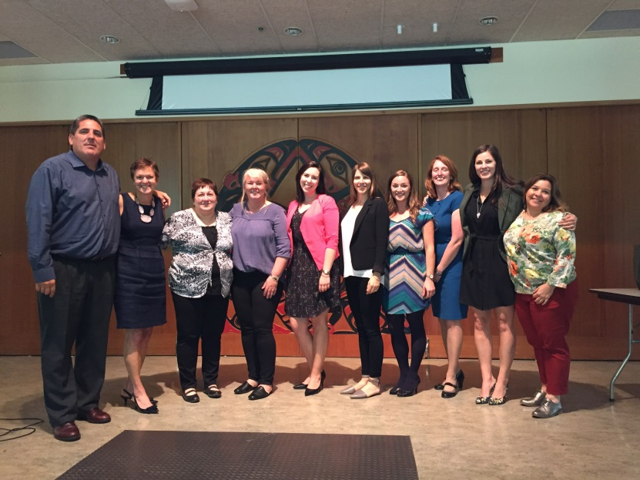
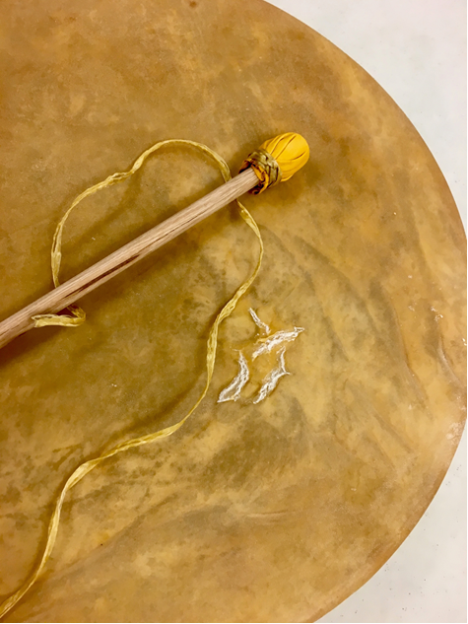

Slide 3
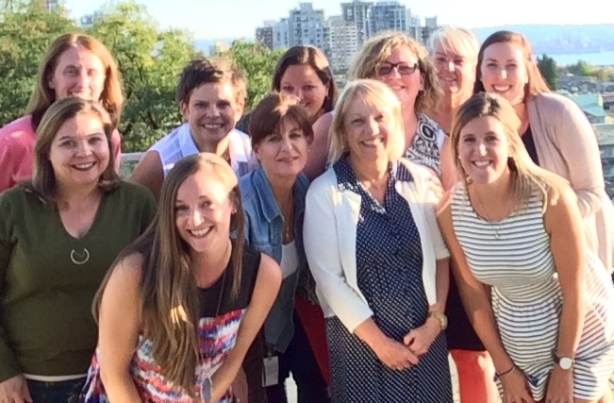
Team Members
Julie Bertrand
Kammi Clark
Jenny Crowe
Jillian Gordon
Johneen Harris
Pat Murray
Heather Myhre
Nicky Paiuk
Nadya Rickard
Darlene Sulis
Ilona Wardas

Slide 4
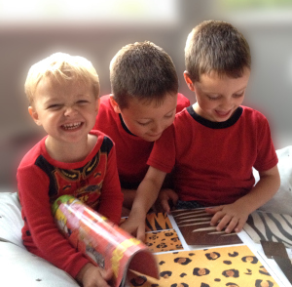
This year’s program
September 26 or 27, 2016
8:30am - 3:00pm
February 6, 2017
4:00pm - 7:00pm
Faye Brownlie
Dinner

Slide 5
Understanding the impact of instructional efforts
Why we need Changing Results for Young Readers…

Slide 6
2016-2017 Focus
strategies/ideas for intervention and support for struggling readers
universal, targeted and intensive interventions for students who struggle with reading
build the literacy community in your school
What do you want your literacy program to look like ?

Slide 7
September 26/27 Agenda
8:30am - 9:00am
Welcome | Mountain View
Making Connections | Mountain View
9:00am - 10:00am
Topic | Colour | Room
Word Knowledge | Red | Ocean View (5th)
Comprehension | Green | Mountain View
Reading and Fluency | White | Reid (main)
Developmental Sequence of Reading | Yellow | Davidson (4th)
Notes:
How we got to these topics:
teacher/ school survey - sent topics they were interested in learning more about
UbD – end goals?
2 sessions
sustained opportunities to collaborate
feedback opportunities
Web site - updates and feedback loop

Slide 8
Putting The Pieces Together
Notes:
NICKY

Slide 9
Agenda
10:00am - 1:00pm
Coffee Break | Sky View
School teams - Jigsaw | Mountain View
School teams How will your team present today’s information to your staff? How will you move your school forward with the literacy agenda? What is your literacy plan ? | Mountain View
Lunch
What do you want your literacy program to look like ?
Notes:
How we got to these topics:
teacher/ school survey - sent topics they were interested in learning more about
UbD – end goals?
2 sessions
sustained opportunities to collaborate
feedback opportunities
Web site - updates and feedback loop

Slide 10
Agenda
1:00pm - 3:00pm
Assessment | Mountain View
Critical Literacy | Mountain View
Wrap up and February | Mountain View
Notes:
How we got to these topics:
teacher/ school survey - sent topics they were interested in learning more about
UbD – end goals?
2 sessions
sustained opportunities to collaborate
feedback opportunities
Web site - updates and feedback loop

Slide 11
Literacy Resources
https://cr4yr.ca/
http://literacy44.ca
http://nvsd44curriculumhub.ca/
Notes:
Jillian
https://cr4yrintermediate.wordpress.com
literacy44.ca
CR4YR has handouts and information about each session
Literacy44 has the resources from Reading 44 and Writing 44, some may have had presentations about literacy44 at schools
All handouts at today’s sessions are available online… handouts for other sections
Website links
Links to click from slide
Morning of… browser windows minimized and ready to pull up

Slide 12
Principles of Learning
Notes:
.

Slide 13
Self-Regulation & Student-Teacher Connections
Darlene Sulis

Slide 14
Big Ideas
Regardless of tools, strategies or program used, relationship building and nurturing is integral in student learning.
Students learn as much if not more from what we do as teachers and how we are, than from what we say.
Everyday we have the opportunity to teach with our words, our physical presence and our emotional response.

Slide 15
Perspective
“You might not be able to change certain things in your life, at work, or at home, but you can change how you experience those immutable aspects of life, work, and home.”
– Deborah Schoeberlain David

Slide 16
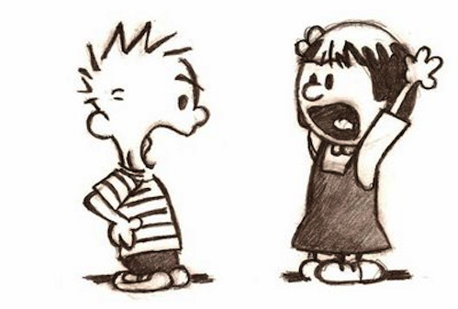
Reflect
Reflect on your practice, try to recall a particularly challenging situation with a student or group of students. What, if any, strategy did you draw on to respond to the situation in a loving and understanding way?

Slide 17
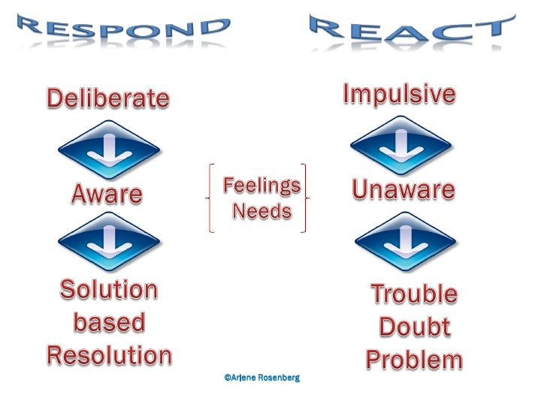
Responding vs Reacting
What techniques support responding rather than reacting to our students and colleagues?

Slide 18
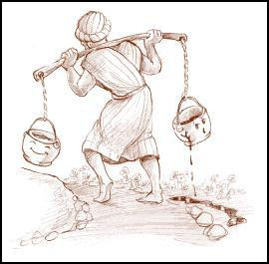
Embracing Imperfection
How does the way we see inside inform the way we see outside?

Slide 19
Helpful Seeds
“We all have helpful and unhelpful seeds of emotion inside us. Depending on what seeds we choose to water, certain seeds grow more than others.”

Slide 20
It Comes Down to ‘POWER’
Historically, linear, fear-based approaches to changing behaviour have been the default approach in education.
What does power mean to you?
What does power look like in your literacy practice?

Slide 21
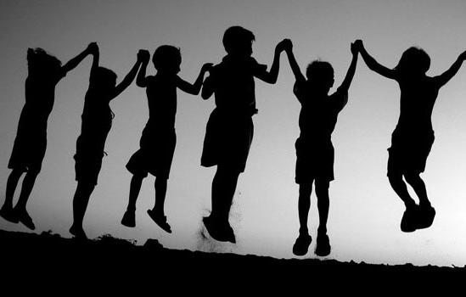
Two Definitions of ‘Power’
“To assert your will even against the will of others.”
“To be all that you can be and to help others be all that they can be too.”

Slide 22
Yes, but…
What does power look like in a circular, relational, internally driven world?

Slide 23
Therefore…
To avoid a reductive, linear approach, we have to look at the big questions of education...
Then we can decide on an overall curricula and strategies.
Then we are in a position to determine what curricular approaches work most effectively.
Then we are in a better position to decide what is ethical and what is not, with regard to curriculum and pedagogy, and how we treat and address our struggling readers.

Slide 24
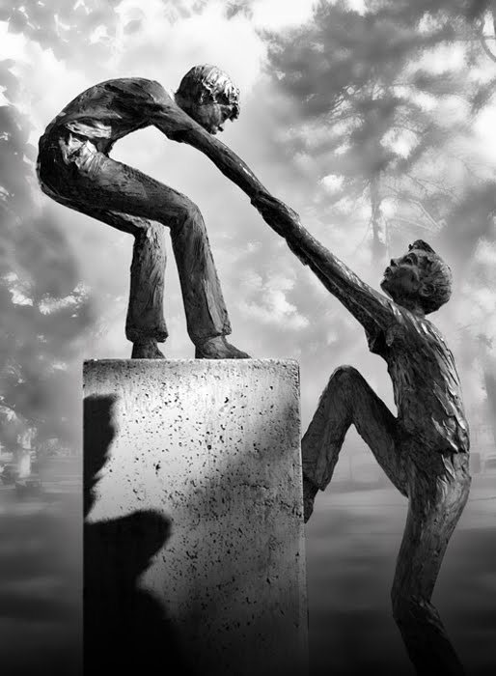
It’s Simple!
It’s not about doing… it’s about being.
Be something! Be in relation.
Address the whole child in needs of that child, considering sociocultural, historical and other contexts.

Slide 25
Parker Palmer…
“Good teachers share one trait: they are truly present in the classroom, deeply engaged with their students and their subject….[they] are able to weave a complex web of connections among themselves, their subjects, and their students, so that their student can learn to weave a world for themselves. The connections made by good teachers are held not in their methods but in their hearts.”
Parker Palmer,
The Courage to Teach

Slide 26
References
References for CR4YR Presentation – Darlene Sulis
Schoeberlein, Deborah. Mindful Teaching and Teaching Mindfulness; A Guide For Anyone Who Teaches Anything. (slide 3)
Meena Srinivasan. Teach Breathe Learn. (slide 9)
Kim Hudson. Two Culture Talks. https://2culturetalks.wordpress.com/2013/10/30/two-different-operating-systems/ (slide 10/11)
The Cracked Pot
http://amazingwomenrock.com/the-story-of-the-cracked-pot-for-anyone-whos-not-quite-perfect (slide 6)

Slide 27
Break Out Sessions
9:00am - 10:00am - Break out Sessions
Topic | Colour | Room
Word Knowledge | Red | Ocean View (5th)
Comprehension | Green | Mountain View
Reading and Fluency | White | Reid (main)
Developmental Sequence of Reading | Yellow | Davidson (4th)
Notes:
How we got to these topics:
teacher/ school survey - sent topics they were interested in learning more about
UbD – end goals?
2 sessions
sustained opportunities to collaborate
feedback opportunities
Web site - updates and feedback loop

Slide 28
Agenda
10:00am - 1:00pm
Coffee Break | Sky View
School teams - Jigsaw | Mountain View
School teams How will your team present today’s information to your staff? How will you move your school forward with the literacy agenda? What is your literacy plan ? | Mountain View
Lunch
Notes:
How we got to these topics:
teacher/ school survey - sent topics they were interested in learning more about
UbD – end goals?
2 sessions
sustained opportunities to collaborate
feedback opportunities
Web site - updates and feedback loop

Slide 29
Putting The Pieces Together
Jigsaw Part 2 = School groups
Notes:
NICKY

Slide 30
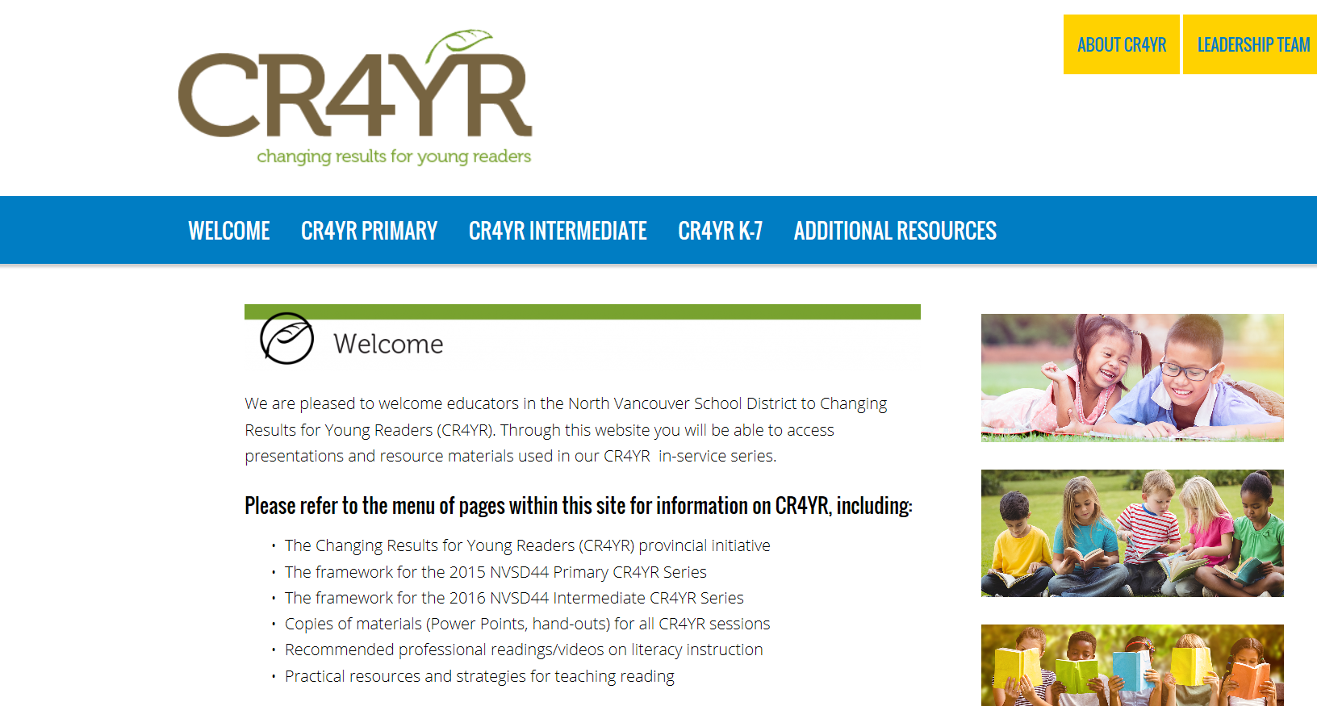
http://cr4yr.ca/

Slide 31
Agenda
1:00pm - 3:00pm
Assessment | Mountain View
Critical Literacy | Mountain View
Wrap up and February | Mountain View
Notes:
How we got to these topics:
teacher/ school survey - sent topics they were interested in learning more about
UbD – end goals?
2 sessions
sustained opportunities to collaborate
feedback opportunities
Web site - updates and feedback loop

Slide 32
Literacy Leaders
How will your team present today’s information to your staff? How will you move your school forward with the literacy agenda? What is your literacy plan ? What happens next?

Slide 33
Feedback Survey

Slide 34
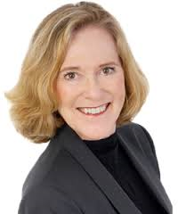
Session Two
February 6, 2017
4:00pm - 7:00pm
Faye Brownlie

Slide 35
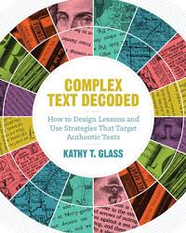
Door Prizes

